Slide 1

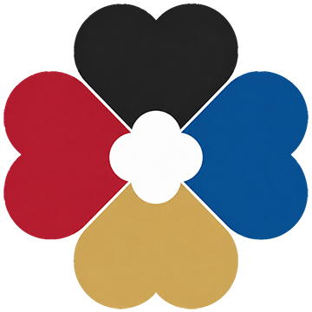
Huaven Civilization Initiative
Global Layout Presentation
For hub node investors and global agency partners
Building future-oriented intellectual-civilization infrastructure through civilizational spaces, global nodes, collaboration platforms and multilingual translation systems.
V1.1 · 2026
HC-C01-P00-PR00-PRM-PPT-S1-V1.1-EN-20260610001
Huaven Civilization Initiative
1

Slide 2
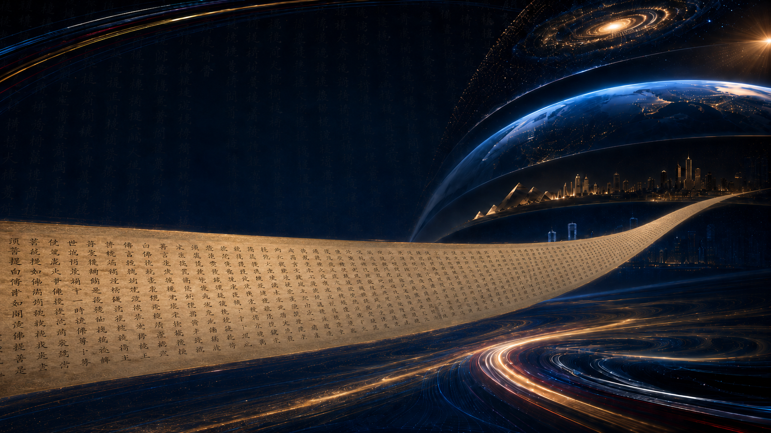

Huaven Civilization Initiative
Origin: A 3,600-meter Grand Scroll
From ten years of intellectual practice to the launch of a civilizational initiative
Initiator: Hua Zhongping
He used writing as a way to train thinking and refine the mind.
Over ten years, he read and transcribed classics, gradually completing several thousand meters of Chinese classical scrolls.
Through long-term writing, organization and intellectual practice, he formed the basic idea for launching the Huaven Civilization Initiative.
HC-C01-P00-PR00-PRM-PPT-S1-V1.1-EN-20260610001
Huaven Civilization Initiative
2

Slide 3
Huaven Civilization Initiative
Creating a rare 3,600-meter Grand Scroll
Using a classical scroll as a model for reading classics and a compelling opening for the initiative.
The scroll reserves 108 spaces for elite representatives from global fields to inscribe section titles.
Launch the “Ten Thousand People, Ten Thousand Seals” program for witness and co-creation.
Create a 3,600-meter Chinese classical grand scroll co-created by ten thousand participants.
Produce nine unique 3,600-meter civilizational scrolls based on the original and place them around the world.
Use talent outreach, system building, mass participation and scroll exhibitions to support the initiative.
Continuously open the Huaven Civilization Initiative around the world.
The 3,600-meter scroll includes full texts, excerpts and catalogs of 64 Chinese classics across nine sections: enlightenment, Daoism, Confucianism, Buddhism, classical schools, history, military thought, Chinese medicine, and poetry.
HC-C01-P00-PR00-PRM-PPT-S1-V1.1-EN-20260610001
Huaven Civilization Initiative
3

Slide 4

Huaven Civilization Initiative
Human civilization faces five major imbalances
These imbalances explain why the Huaven Civilization Initiative is needed.
Imbalance in language and civilizational communication
Imbalance between cognitive scale and action capacity
Imbalance between resource input and civilizational gaps
A few dominant languages hold excessive communication power, leaving many civilizational achievements outside global knowledge circulation.
Human cognition reaches cosmic scales of roughly 90 billion light-years, while our practical mobility remains constrained to less than one light-second from Earth.
Much talent and capital are trapped in red-ocean competition, while many civilizational gaps remain unfilled.
Imbalance between resource possession and collective evolution
Imbalance between civilizational accumulation and backup
A minority holds excessive resources, knowledge and opportunities, while the abilities and participation of the majority do not rise in parallel, slowing human progress as a whole.
Civilizational achievements have accumulated massively, but lack systematic backup mechanisms for disasters and restart scenarios.
The Huaven Civilization Initiative is a global response to these imbalances: from observing imbalance to organizing mutual translation; from spatial experience to node collaboration; from civilizational display to civilizational backup.
HC-C01-P00-PR00-PRM-PPT-S1-V1.1-EN-20260610001
Huaven Civilization Initiative
4

Slide 5
Huaven Civilization Initiative
Multi-Dimensional Balanced Observation: From problems to methods
Turning large-scale judgments into executable civilizational engineering pathways
Cosmic Scale
Multi-Dimensional Balanced Observation
Civilizational Mutual Translation
From Observation to Transformation
Global Collaboration
The cosmic macro-scale reminds us of our smallness; the atomic micro-scale reminds us of our roughness. Only by improving capability at both ends can humanity truly advance.
Multi-dimensional thinking means examining issues from multiple dimensions, weighing tradeoffs, balancing resources, observing facts and structures, and redirecting resources accordingly.
Let ideas, methods, classics and experiences flow across languages so different civilizations can be understood, communicated, preserved and recreated.
Use intuitive exhibitions to let people see the most advanced, classic and inspiring human achievements; seeing leads to understanding, and understanding drives intellectual change.
Connect governments, universities, enterprises, scholars and individuals worldwide so forces across languages, regions and levels can jointly participate in translation, exhibition, communication, backup and recreation.
→
→
→
→
Raise capability through scale, discover problems through balanced observation, balance development through mutual translation, transform thinking through observation, and expand civilization through collaboration.
HC-C01-P00-PR00-PRM-PPT-S1-V1.1-EN-20260610001
Huaven Civilization Initiative
5

Slide 6
Huaven Civilization Initiative
Cosmic-scale concept: from material scarcity to capability scarcity
The universe does not lack matter; humanity lacks the ability to access it.
Core Judgment
Observable Universe
Human Activity Capacity
∞
The universe does not lack matter; humanity lacks the ability to access and transform resources.
approx. 93 billion light-years
Even one light-second is extremely difficult
1 light-second ≈ 300,000 km
Civilizational gaps to be filled far exceed existing answers
HC-C01-P00-PR00-PRM-PPT-S1-V1.1-EN-20260610001
Huaven Civilization Initiative
6

Slide 7
Huaven Civilization Initiative
Opening the Era of Intellectual Civilization
From “material growth first” to “thinking-capability building first”
Why an era of intellectual civilization?
From a material-centered world
Toward a capability-centered world
Humanity is not facing a scarcity of matter, but a scarcity of judgment, creativity, collaboration and the ability to transform thought into action.
Humanity needs more, stronger and more usable AI, automation and tools of all kinds. More importantly, it needs more people to gain the ability to understand, use, modify and create tools.
The explosion of information has produced scattered attention and confused judgment. Humanity needs to reduce the mental consumption caused by ineffective information.
The advancement of a few, if it cannot be transformed into the capability growth of the many, will ultimately be constrained by the insufficient capacity of society as a whole.
Therefore, by developing a civilization of thought, it is imperative to shift humanity’s focus from “producing more material goods” toward enhancing the capacity to understand, judge, collaborate and create the future.
From information accumulation
Toward transformation of thought
From single-language dominance
Toward translation balance
From local competition
Toward global collaboration
From passive consumption
Toward civilizational participation
The initiative seeks to move humanity from material growth toward capability, judgment, collaboration and creation.
HC-C01-P00-PR00-PRM-PPT-S1-V1.1-EN-20260610001
Huaven Civilization Initiative
7

Slide 8
Huaven Civilization Initiative
Civilizational Collaboration Platform: An Operating System for Global Civilizational Cooperation
Integrating civilizational achievements, multilingual translation, problem generation, task collaboration, resource allocation and global linkage into a sustainable platform.
Content Library
Problem Library
Task Collaboration System
Resource Allocation System
Global Linkage System
Continuously integrate knowledge across different languages, forming a civilizational asset library that can be translated, exhibited and transformed into actionable tasks.
Build a Civilizational Radar that generates a Civilizational Gap Map through multidimensional scanning, continuously identifying gaps and deficiencies across different fields.
Break civilizational gaps into tasks that can be claimed, executed, reviewed and tracked, and organize global resources for collaborative solutions.
Dynamically allocate contributions and rights, surpluses and shortages, funds and projects, tasks and capabilities, so that global resources flow toward the gaps that most need to be filled.
Break down barriers between regions, languages, industries, capital and communities, forming a collaborative network of mutual response and shared construction.
Scan civilizational gaps, organize global collaboration, allocate surplus and scarcity, remove circulation barriers and improve civilizational capability.
HC-C01-P00-PR00-PRM-PPT-S1-V1.1-EN-20260610001
Huaven Civilization Initiative
8

Slide 9
Huaven Civilization Initiative
Civilizational Collaboration Protocols: Foundational rules for healthy platform operation
Connect systems, users and content through protocols, and safeguard healthy collaboration through foundational rules.
Protocol Principles
Human-centered, inclusive, farsighted, balanced, truthful, open, diverse, cooperative, universally beneficial, simple, consumption-reducing, efficiency-enhancing, safe, adaptive and sustainable.
Define protocol boundaries
Generate rule details
Clarify the boundaries of content, copyright, identity, data, civilizational value, capital, commerce, AI, security and governance, ensuring that open collaboration does not lose control.
Rules are not written all at once from imagination, but are developed by discovering problems, summarizing experience and solidifying standards through pilot practices in content access, task collaboration, resource allocation and global connectivity.
Layer protocol groups
Revise and evolve versions
Form a layered protocol system covering general principles, business rules, technical standards, governance and compliance, regional adaptation and version evolution, enabling a complex system to operate in an orderly manner.
Through trial periods, version numbers, feedback mechanisms, expert review, phased implementation, exception handling and regular upgrades, the protocol can continuously adapt to unknown future changes.
HC-C01-P00-PR00-PRM-PPT-S1-V1.1-EN-20260610001
Huaven Civilization Initiative
9

Slide 10
Huaven Civilization Initiative
Implementation Mechanism for Multilingual Mutual Translation
Mutual translation makes Earth’s civilizations one family.
What to translate? Human civilizational achievements
How to translate? Civilizational translation workflow
Who translates? Global collaborators
Result? Maximize the value of civilizational achievements
Enable civilizational achievements in different languages to enter a shared structure for all humanity, and allow the integration of achievements from different civilizations to incubate deeper-level civilizational outcomes.
Build intelligent tools and use them to enable large-scale, tool-driven human-AI collaboration.
Human contributors will carry out error correction, translation review, concept confirmation, cultural interpretation and contextual supplementation.
The platform will turn these processes into accumulated outcomes, generating terminology libraries, concept libraries, context libraries, version libraries and feedback records, so that every revision becomes the foundation for the next round of mutual translation.
Intelligent tools.
Authors, scholars, translators, native speakers, institutions and nodes.
Governments, cultural departments, education departments, libraries, national language and translation institutions, and other relevant bodies.
This is not a mass-style translation campaign based on sheer manpower.
Multilingualization of individual achievements amplifies their value.
Language functions are upgraded through mutual translation.
Regional civilizations are upgraded by introducing civilizational achievements from other languages.
This process feeds back into the upgrading of human tools.
The multilingual backup of human civilizational achievements creates stronger resilience against civilizational rupture.
Implementation mechanism: translate human civilizational achievements through tools and global collaborators.
HC-C01-P00-PR00-PRM-PPT-S1-V1.1-EN-20260610001
Huaven Civilization Initiative
10

Slide 11
Huaven Civilization Initiative
The platform builds the stage; language communities take the lead
Give every language and every person an entrance to civilization.
The platform builds the stage so language communities, institutions, governments and individuals can take the lead.
Individuals
Institutions
The platform builds the stage so language communities, institutions, governments and individuals can take the lead.
Government
The platform builds the stage so language communities, institutions, governments and individuals can take the lead.
Platform
Build a global ecosystem for civilizational translation so every language has an entrance and every achievement can circulate across languages.
Let every language have a world entrance, and let every person’s thoughts and creations be recorded by history.
HC-C01-P00-PR00-PRM-PPT-S1-V1.1-EN-20260610001
Huaven Civilization Initiative
11

Slide 12
Huaven Civilization Initiative
How is content generated?
From knowledge base to civilizational information-generation engine
capture signals of ideas from questions, debates, experiences, individuals, local practices and folk wisdom, so that civilizational value that has not yet been written, named, or seen can be discovered, organized and amplified.
Break away from the traditional model of translating by words and sentences. Instead, extract concepts, questions, logic, scenarios and methods, then regenerate knowledge expressions in the target language that are understandable, usable and extendable. The system can also directly generate differentiated versions for children, general readers and researchers.
Transform result-driven organization into question-driven organization: rather than merely displaying existing knowledge outcomes, organize knowledge around the future development needs of human beings. Each question connects viewpoints, cases, debates, solutions, tools and action pathways, enabling knowledge to continuously generate around real problems.
No longer determine value through simple judgments of good or bad, right or wrong, or popularity. Instead, annotate content across multiple dimensions, including facts, logic, reality, long-term relevance, risk, creativity and civilizational significance, so that minority insights, local experiences and long-term value are not drowned out by majority preferences.
No longer let people passively receive knowledge. Instead, enable users to improve their powers of observation, judgment, creativity and civilizational participation through discovering problems, breaking down problems, comparing civilizations, participating in annotation, conducting human-AI simulations, creating expressions and making continuous revisions.
Content generation turns knowledge bases into an engine for thought discovery, concept generation and capability growth.
HC-C01-P00-PR00-PRM-PPT-S1-V1.1-EN-20260610001
Huaven Civilization Initiative
12

Slide 13
Huaven Civilization Initiative
What content will be generated?
From civilizational achievements to a usable, collaborative and growth-oriented content system
Generate a Civilizational Achievements Library that brings together classics, works, papers, courses, tools, individuals and local documents, forming civilizational assets that are searchable, translatable and transmissible.
Generate a Civilizational Gap Map that scans gaps and fractures across knowledge, languages, capabilities, institutions and regions, forming a continuously updatable map of civilizational deficits.
Generate a Question Library that continuously accumulates questions, debates, cases and experiences around personal, social, technological and civilizational development, forming an open network of questions.
Generate a Task List that breaks civilizational gaps and key questions into global collaborative tasks that can be claimed, executed, reviewed and tracked.
Build a Resource Allocation System that dynamically matches funds, talent, tools, institutions, projects and needs, enabling resources to flow toward the areas where support and reinforcement are most needed.
Build a Capability Enhancement System that enables users to improve their powers of observation, judgment, creativity and civilizational participation through questioning, comparison, annotation, simulation, expression, collaboration and evaluation.
HC-C01-P00-PR00-PRM-PPT-S1-V1.1-EN-20260610001
Huaven Civilization Initiative
13

Slide 14

Huaven Civilization Initiative
Initial Global Layout of the Huaven Civilization Initiative
Six functional headquarters and 18 civilizational hub nodes
Initial global layout: six functional headquarters and eighteen civilizational hub nodes.
18 civilizational hub nodes will form the first-stage global layout.
Starting with 18 language translation centers, the network will gradually expand to more than 70 language translation centers.
It will cover major written languages with populations of over ten million users and connect the world’s major civilizational regions.
London
Moscow
Paris
Berlin
New York
Istanbul
Tokyo
Los Angeles
Cairo
Shanghai
Mexico City
Dubai
New Delhi
Hong Kong
Singapore
Johannesburg
São Paulo
Sydney
HC-C01-P00-PR00-PRM-PPT-S1-V1.1-EN-20260610001
Huaven Civilization Initiative
14

Slide 15
Huaven Civilization Initiative
Layout of Six Functional Headquarters
Supporting global operations through coordination, technology, content, resources, expansion and talent.
Global Coordination HQ
Proposed location: Hong Kong, responsible for global coordination, protocol rules, brand management and international cooperation.
Technology & Systems HQ
Proposed location: Shanghai, responsible for building the technological foundation, data systems, engineering tools and global collaboration system.
Global Content & Multilingual HQ
Proposed location: New York, responsible for global content access, multilingual translation, copyright cooperation, collaboration with international knowledge institutions, and overall coordination of all global translation centers.
Resource Coordination HQ
Proposed location: Dubai, responsible for capital, funds, physical materials, construction resources and supply chain coordination.
Global Expansion HQ
Proposed location: Singapore, responsible for expanding civilizational nodes, translation centers and civilizational spaces, as well as cooperation with governments and institutions across different countries.
Talent & Education HQ
Proposed location: Paris, responsible for talent discovery, civilizational education, curriculum systems, art curation and academic cooperation.
HC-C01-P00-PR00-PRM-PPT-S1-V1.1-EN-20260610001
Huaven Civilization Initiative
15

Slide 16
Huaven Civilization Initiative
Attributes and responsibilities of the 18 civilizational hub nodes
Regional window, language translation, node incubation, content access, civilizational space and regional expansion
Regional Civilizational Window
Showcase the languages, history, thought, art, education, technology and social experience of the region where each node is located.
Language Translation Pivot
Undertake translation between the major languages of the region and other languages.
Node-center Incubation
First, each node will undertake translation, exhibition and exchange work within its basic region, and will gradually incubate independent branch civilizational nodes.
Content Access Center
Connect universities, publishers, research institutions, cultural institutions, authors, translators and knowledge resources within the region.
Civilizational Space Exhibition
Promote and support the implementation of civilizational spaces, exhibitions, touring exhibitions, courses, study programs and public activities within the region.
Regional Expansion Center
Expand the cooperation network to surrounding countries, cities, language communities and civilizational regions.
HC-C01-P00-PR00-PRM-PPT-S1-V1.1-EN-20260610001
Huaven Civilization Initiative
16

Slide 17
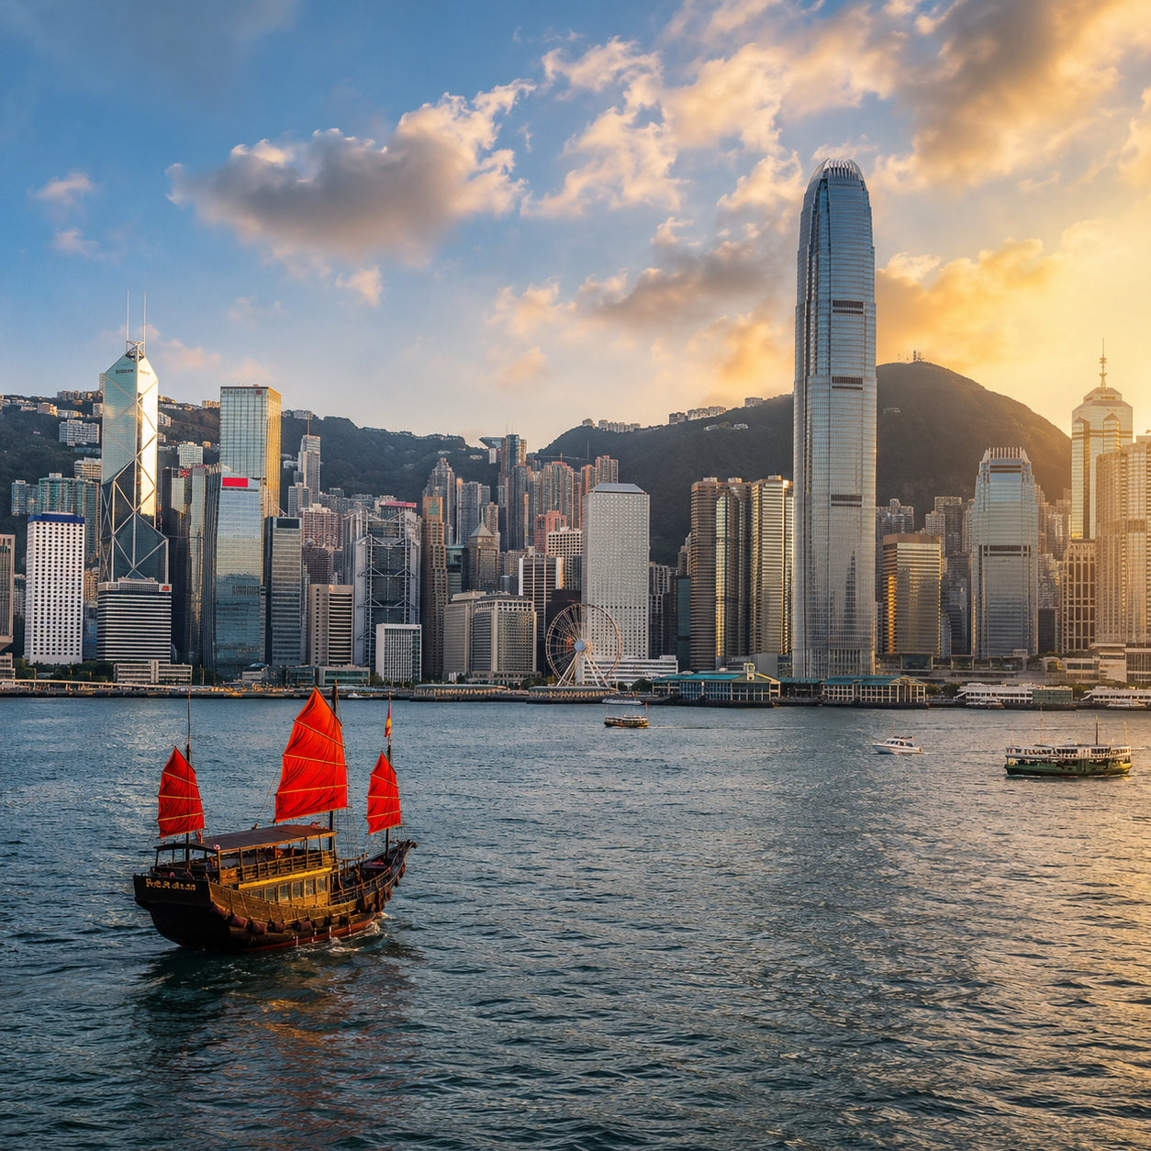
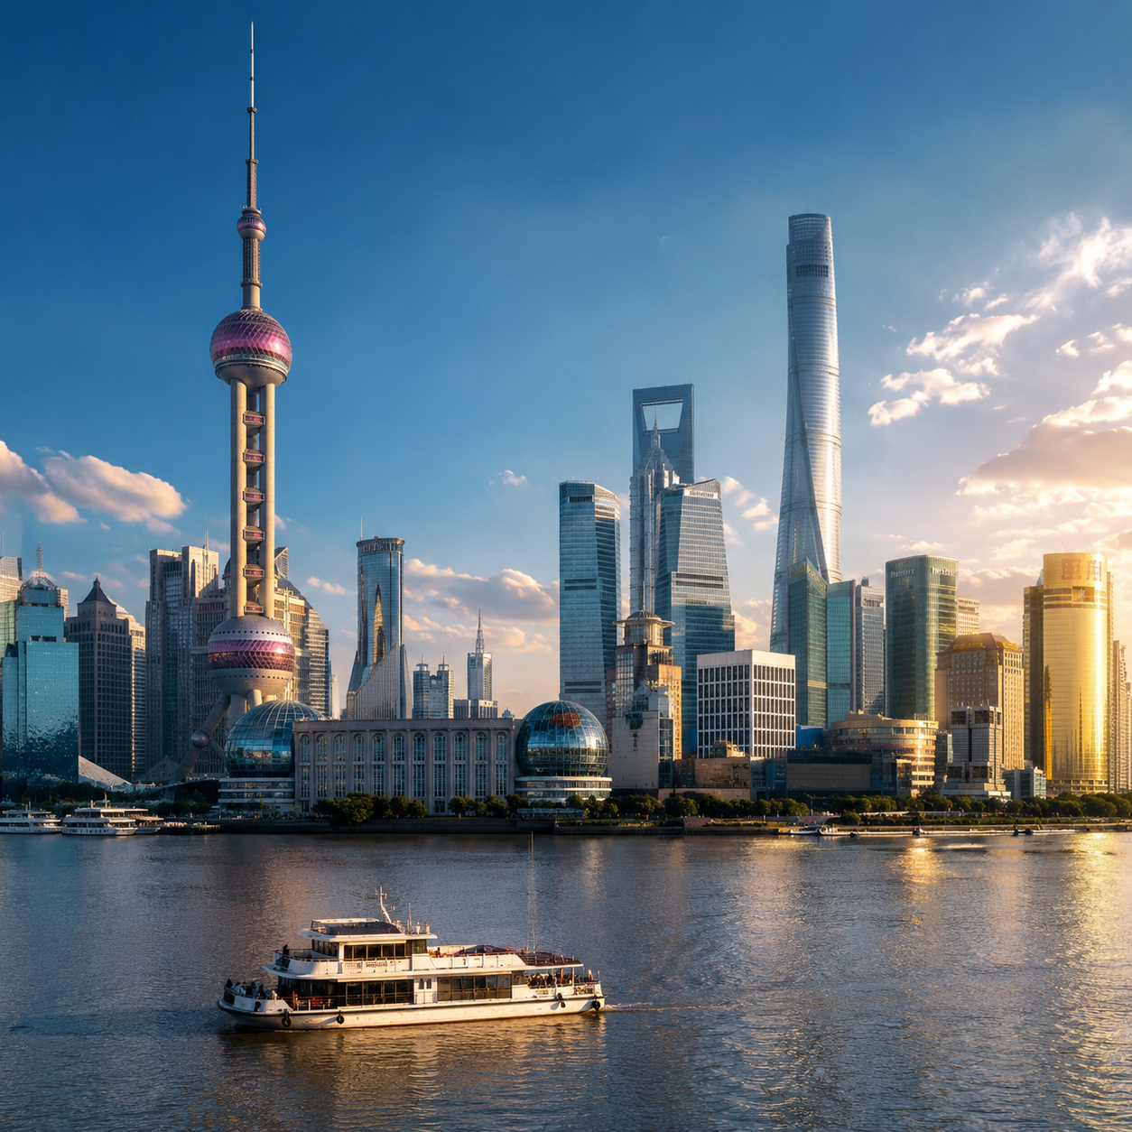
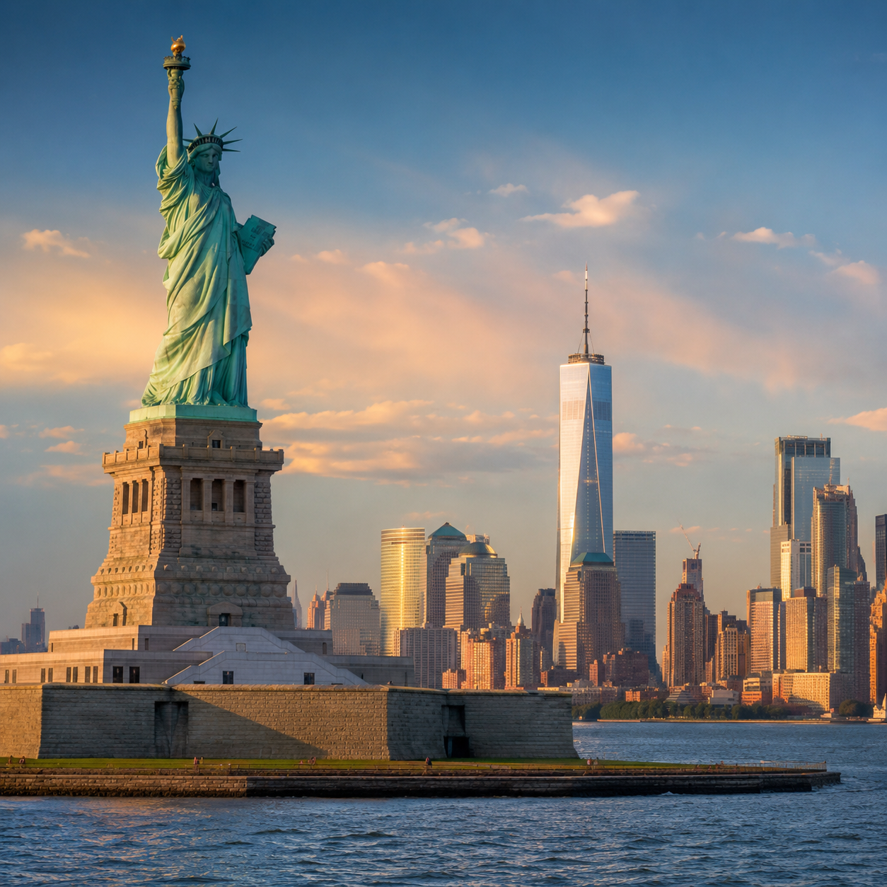
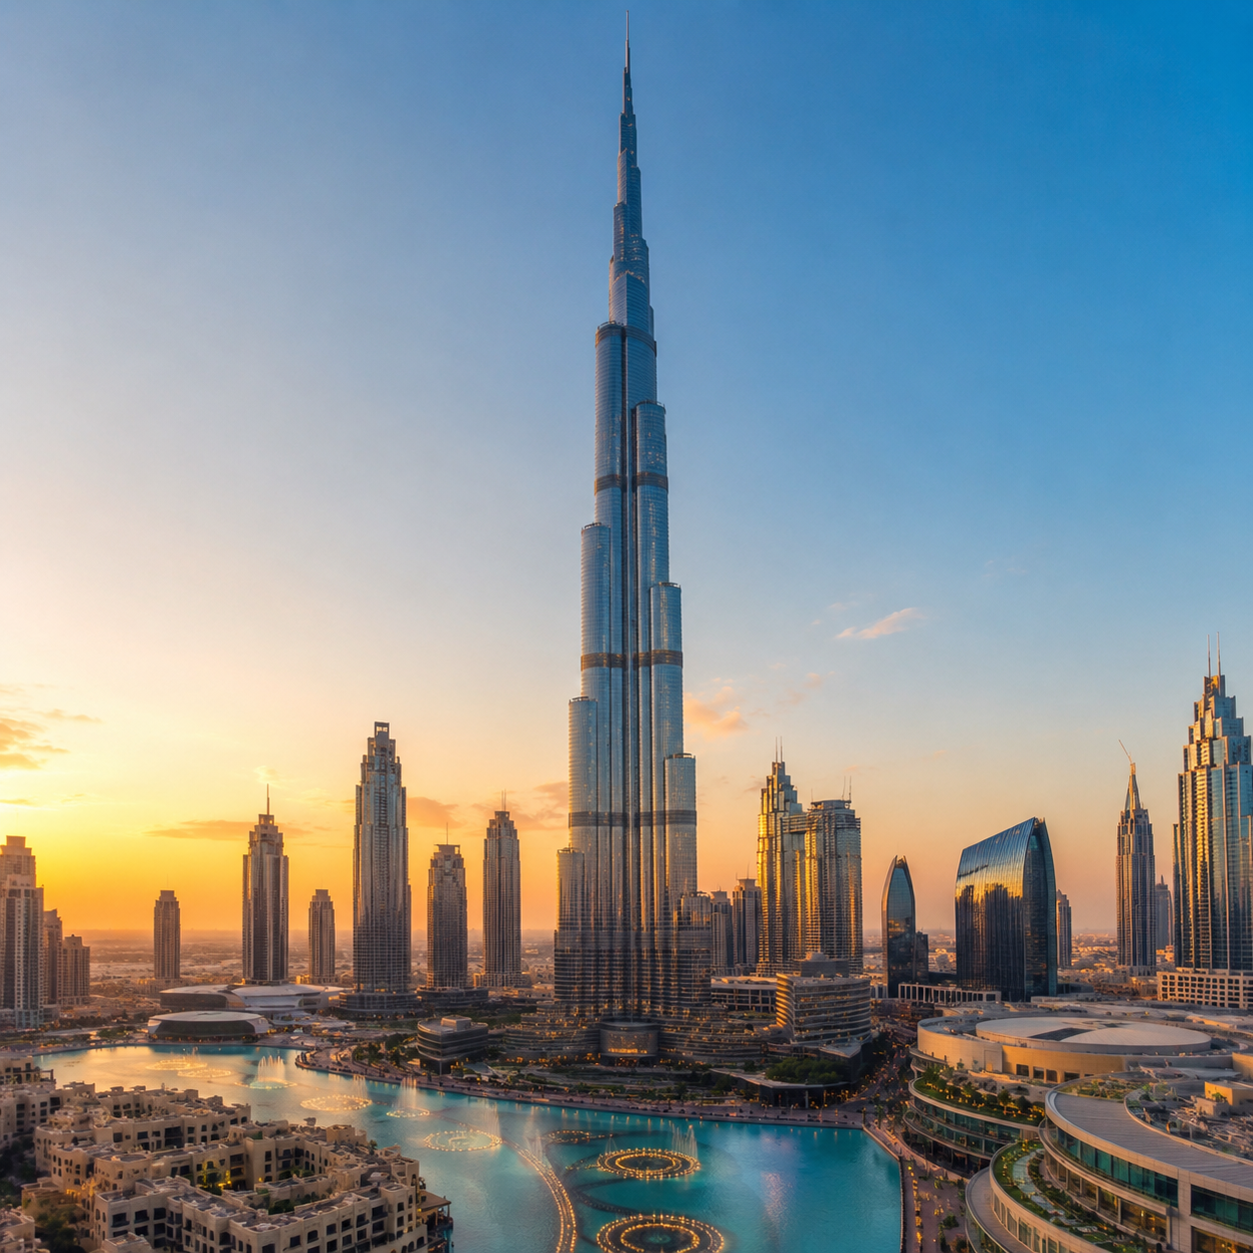
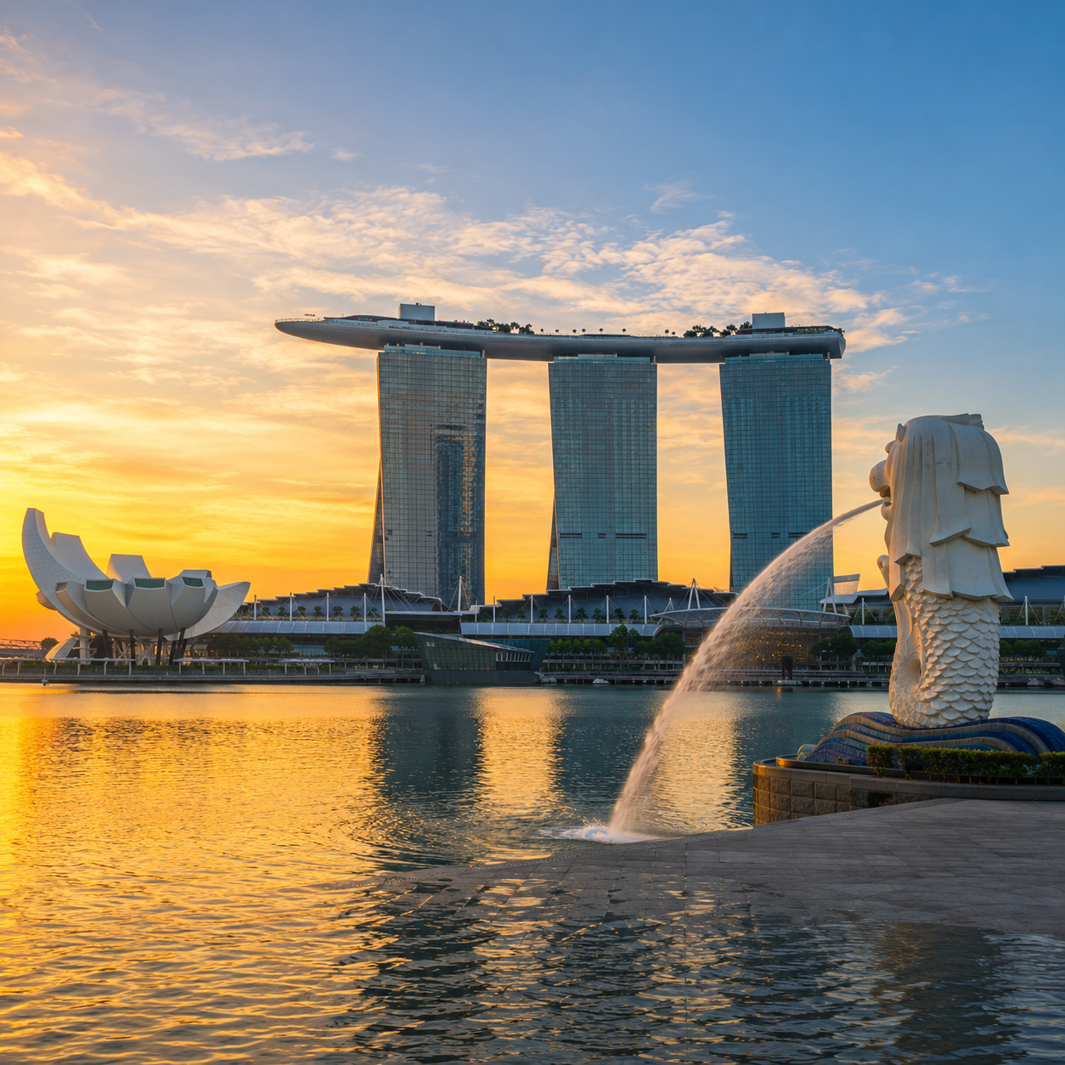
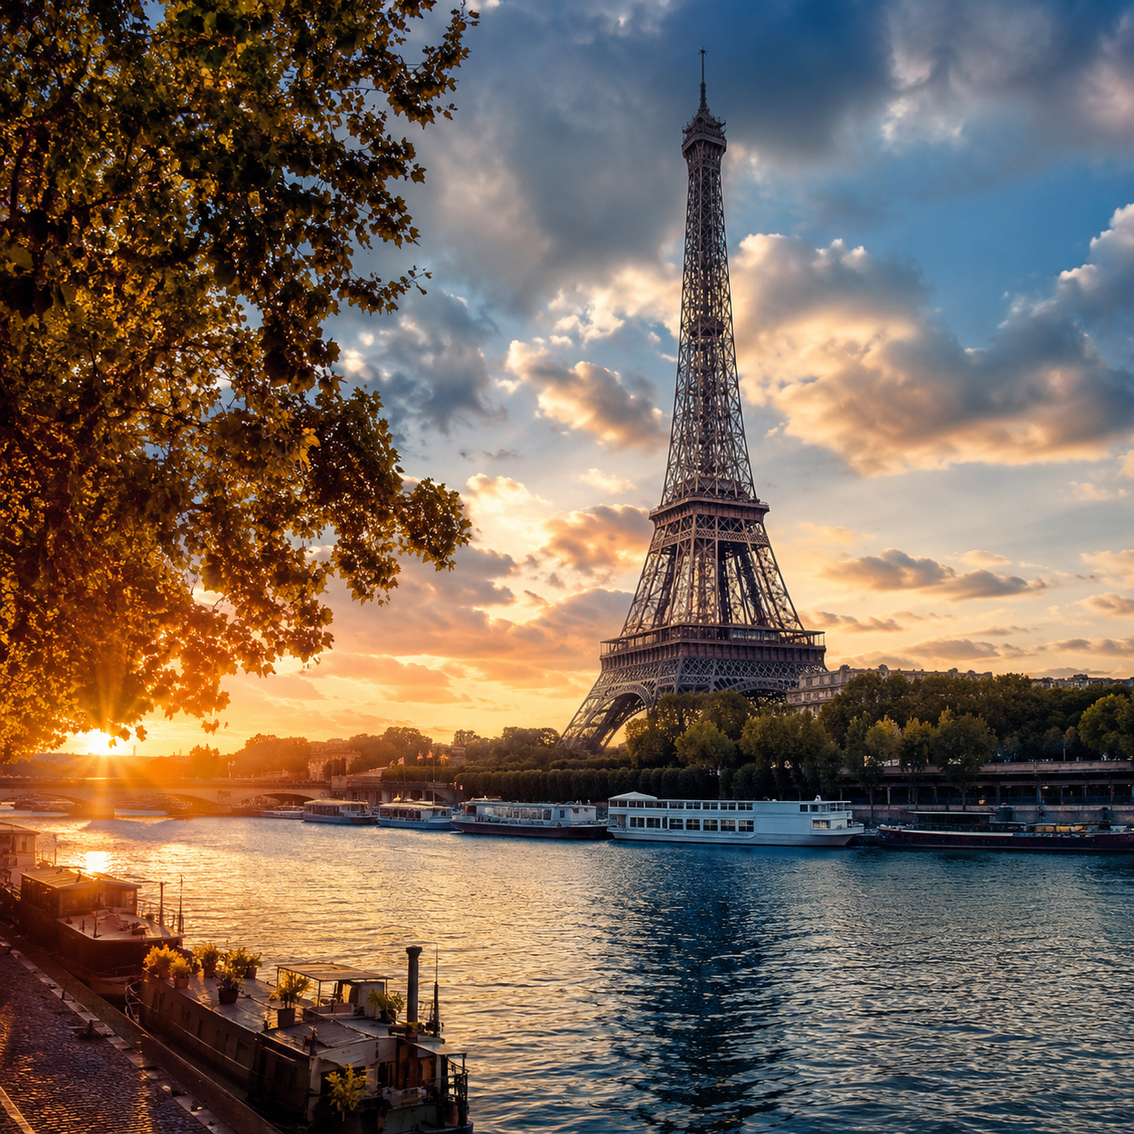
Huaven Civilization Initiative
Regional division of the 18 civilizational hub nodes
Hong Kong-Shanghai-New York-Dubai-Singapore-Paris
Proposed as the Global Coordination Headquarters, responsible for global coordination, protocol rules and brand management, while incubating branch nodes in Hong Kong, Macao and Taiwan.
Proposed as the Technology and Systems Headquarters, responsible for building the technological foundation, data systems, engineering tools and global collaboration system, while incubating branch nodes in mainland China, North Korea and Mongolia.
Hong Kong
Shanghai
Proposed as the Global Content and Multilingual Headquarters, responsible for global content access and multilingual coordination, while also handling matters for languages that have not yet established dedicated translation centers.
Proposed as the Resource Coordination Headquarters, responsible for coordinating capital, funds, physical materials, exhibition equipment and supply chains, while incubating branch nodes for the Arabian Peninsula, the East African trade region, Iran, Afghanistan and Pakistan.
New York
Dubai
Proposed as the Global Expansion Headquarters, responsible for the global expansion and operational standards of civilizational nodes, language translation centers and civilizational spaces, while incubating branch nodes across the eleven ASEAN countries.
Proposed as the Talent and Education Headquarters, responsible for incubating branch nodes in France, Belgium, Luxembourg, the French-speaking regions of Switzerland, Monaco and Andorra, while also linking with Francophone Africa and the Mediterranean French-speaking cultural sphere.
Singapore
Paris
HC-C01-P00-PR00-PRM-PPT-S1-V1.1-EN-20260610001
Huaven Civilization Initiative
17

Slide 18
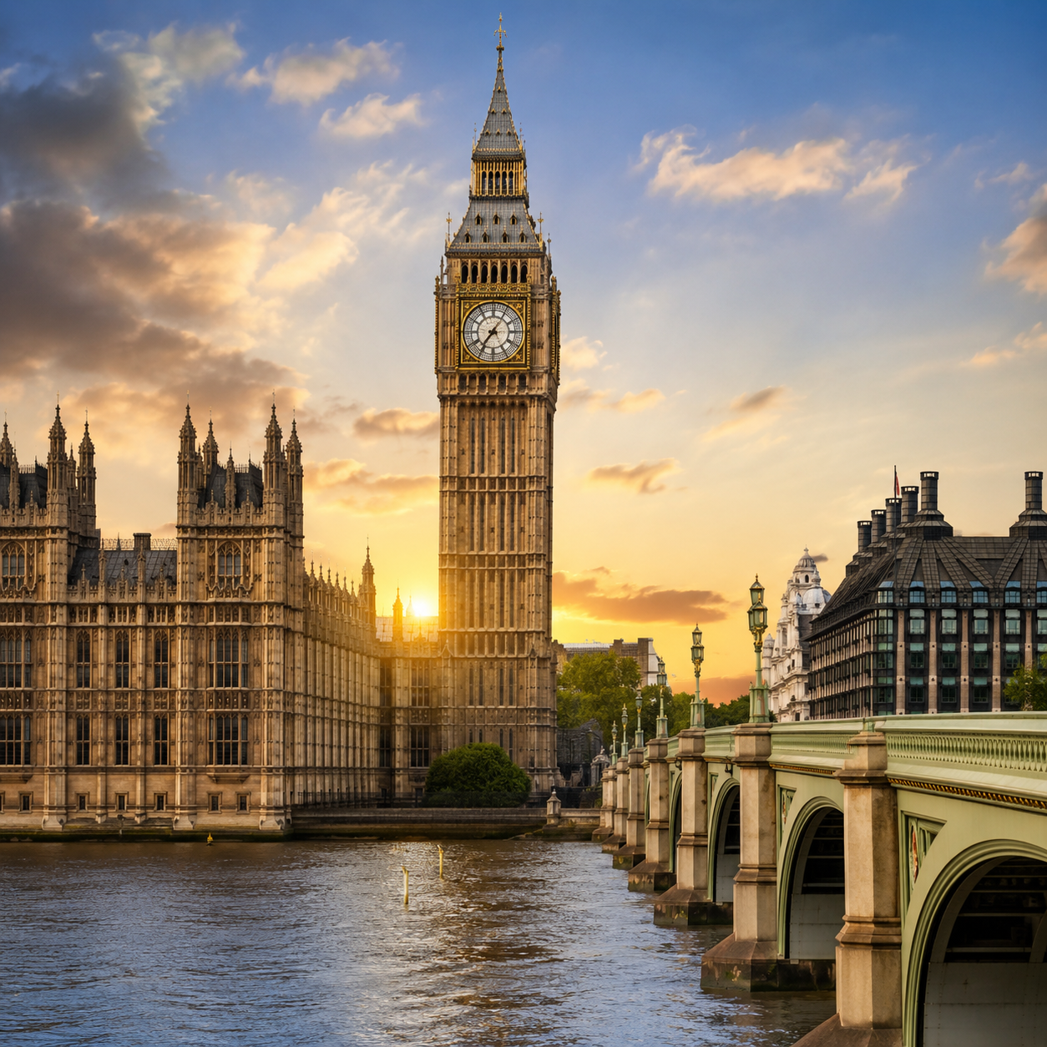
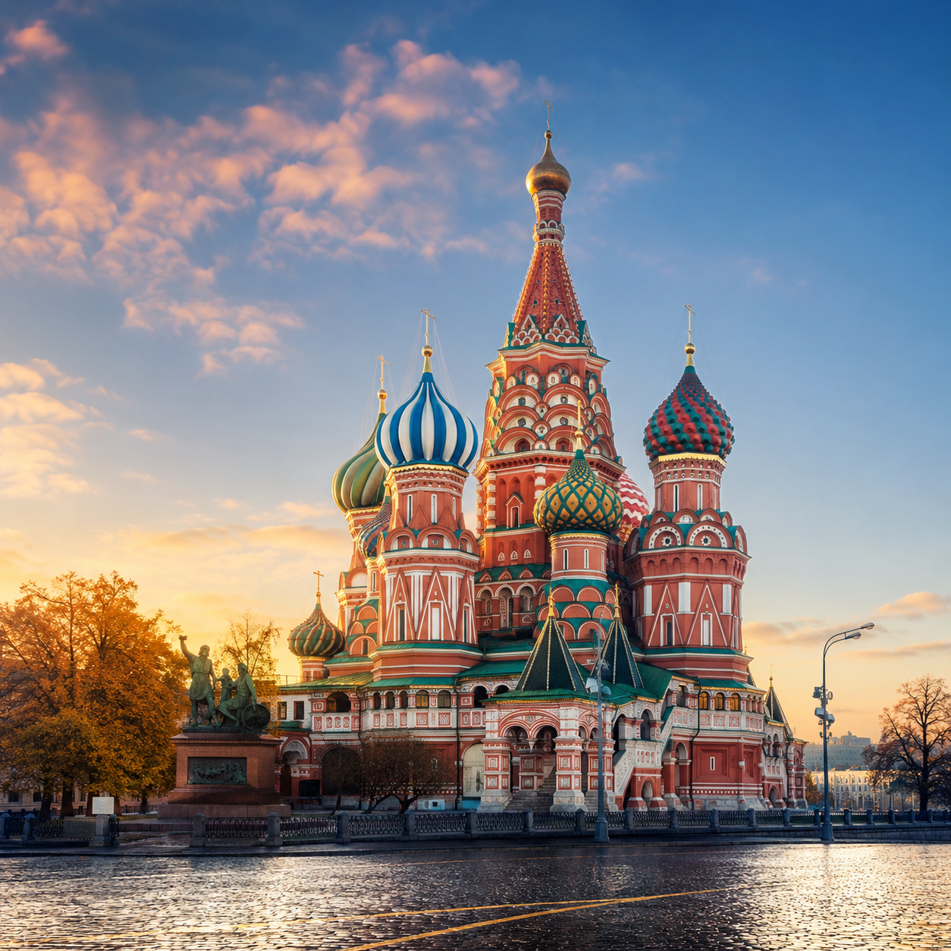
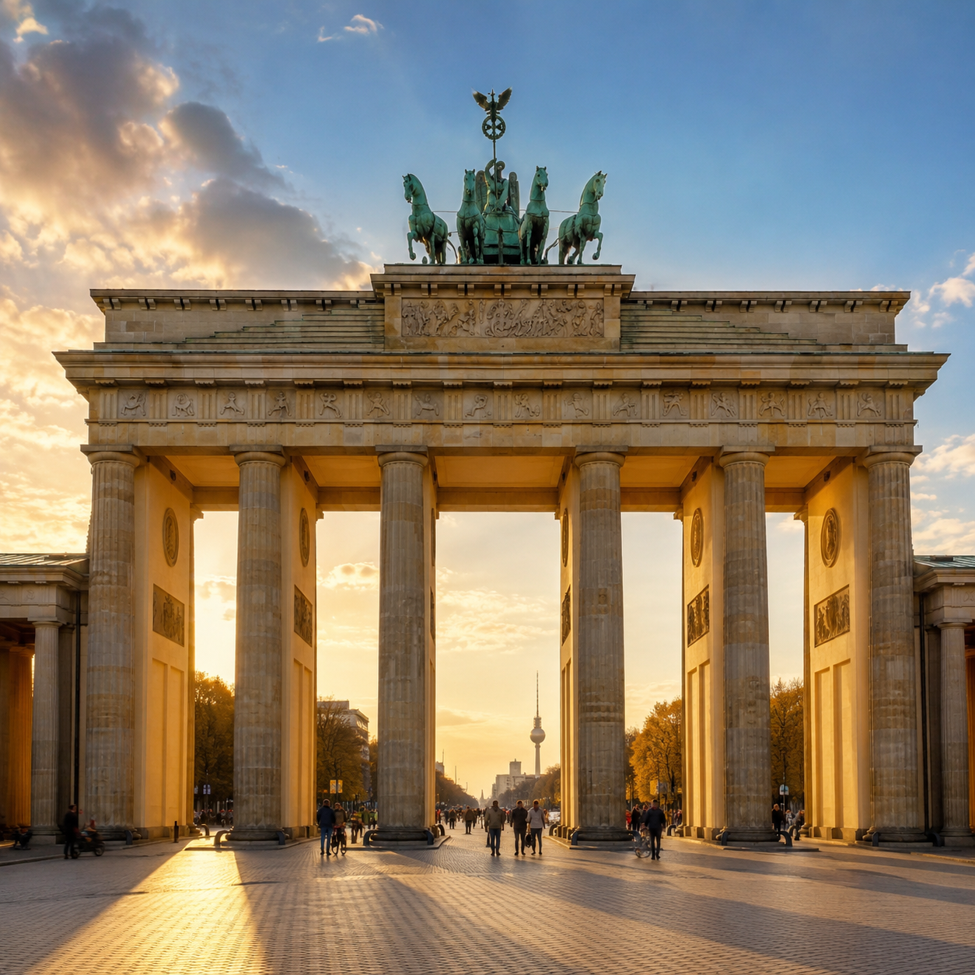
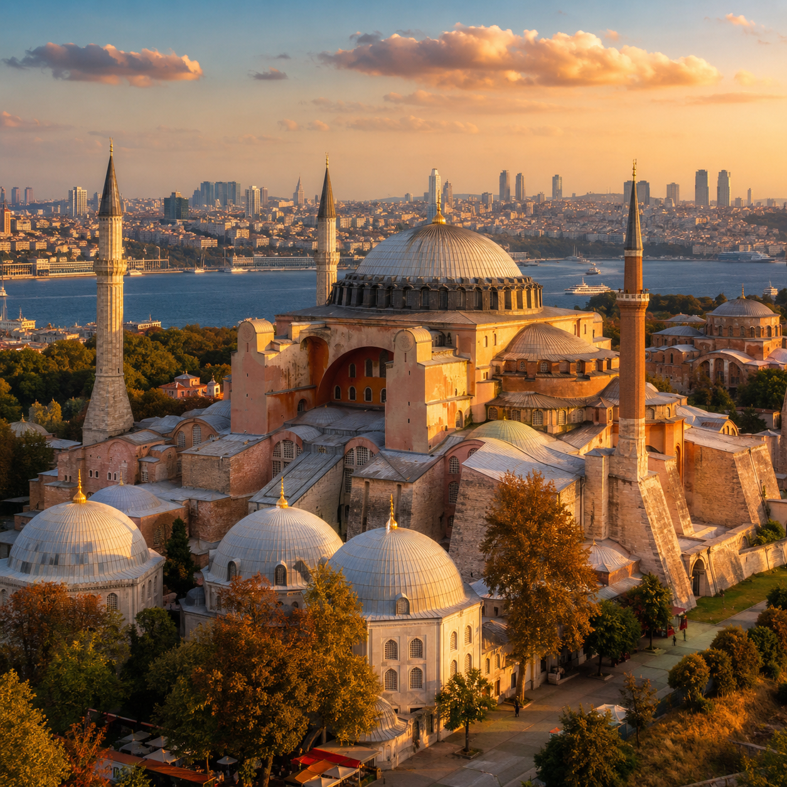
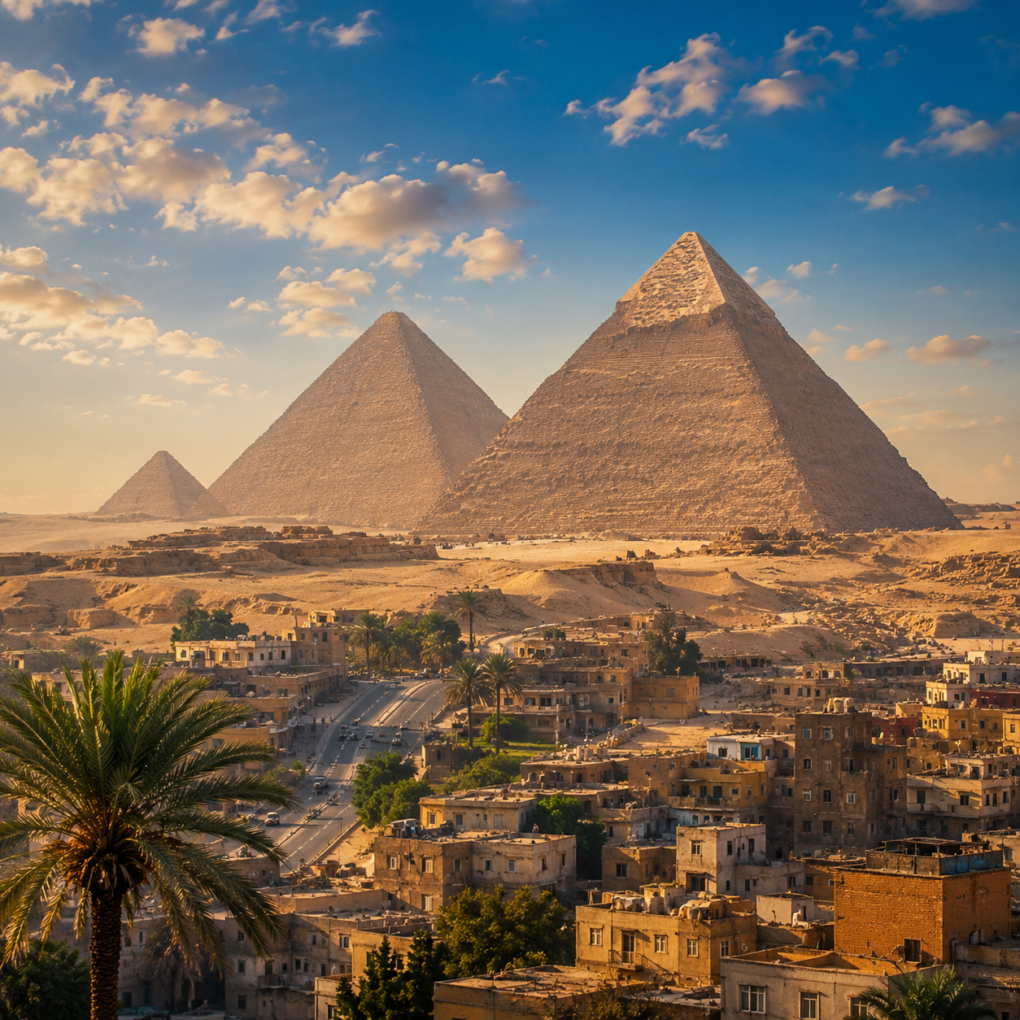
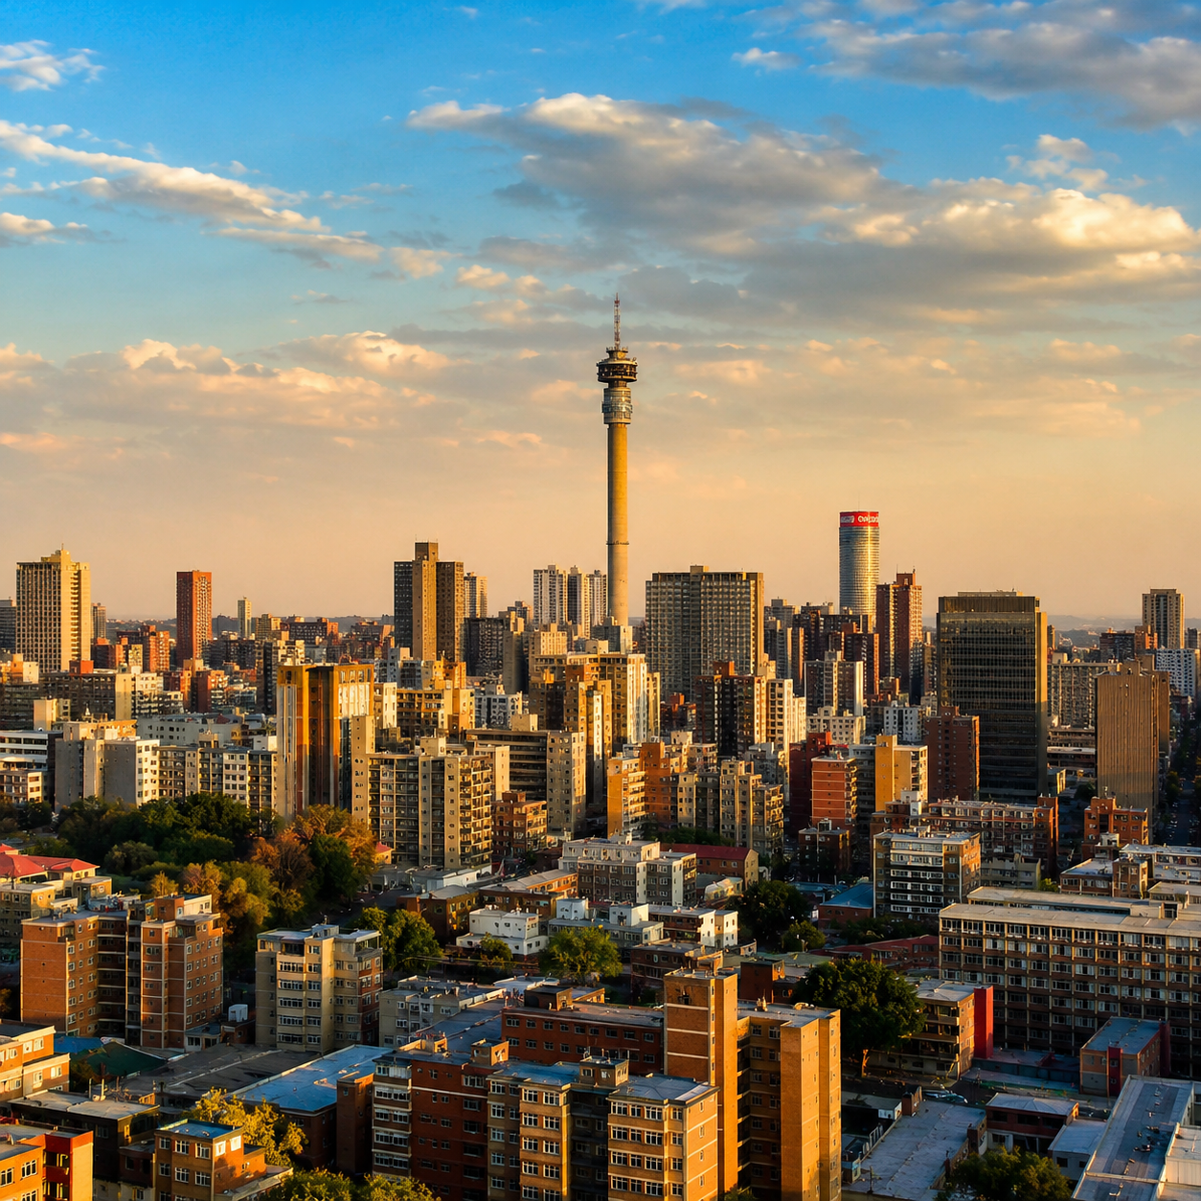
Huaven Civilization Initiative
Regional division of the 18 civilizational hub nodes
London-Moscow-Berlin-Istanbul-Cairo-Johannesburg
Incubate branch nodes in the United Kingdom and Ireland, while linking with Commonwealth countries, the international publishing system, the international copyright system, and legal and financial service networks.Promote the access and translation of content resources in English, Irish, Welsh, Scottish Gaelic and relevant written languages across the Commonwealth.
Incubate branch nodes in Russia, Belarus, the five Central Asian countries and parts of Eastern Europe, while promoting the access and translation of content resources in Russian, Belarusian, Kazakh, Uzbek, Kyrgyz, Tajik, Turkmen and Cyrillic Mongolian.
London
Moscow
Incubate and promote the access and translation of regional and written-language content resources in German, Dutch, Danish, Swedish, Norwegian, Finnish, Icelandic, Polish, Czech, Slovak and Hungarian.
Incubate branch nodes in Turkey, parts of Cyprus, relevant Balkan countries, the Caucasus countries and parts of the Black Sea region, while promoting the access and translation of related regional language content.
Berlin
Istanbul
Incubate branch nodes in Egypt and North Africa, while promoting the access and translation of content resources in Arabic, Egyptian Arabic, Maghrebi Arabic, Hebrew, Amharic, Tigrinya and Somali.
Incubate branch nodes in South Africa and Southern Africa, while promoting the access and translation of written-language content resources across the region.
Cairo
Johannesburg
HC-C01-P00-PR00-PRM-PPT-S1-V1.1-EN-20260610001
Huaven Civilization Initiative
18

Slide 19
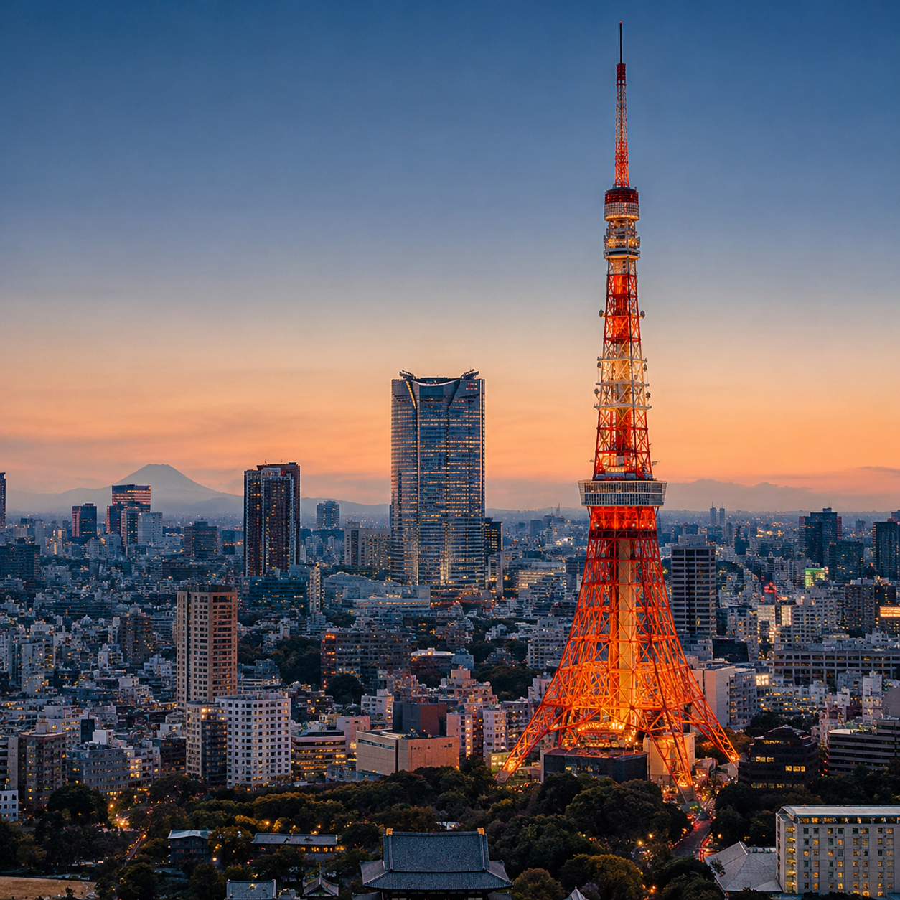
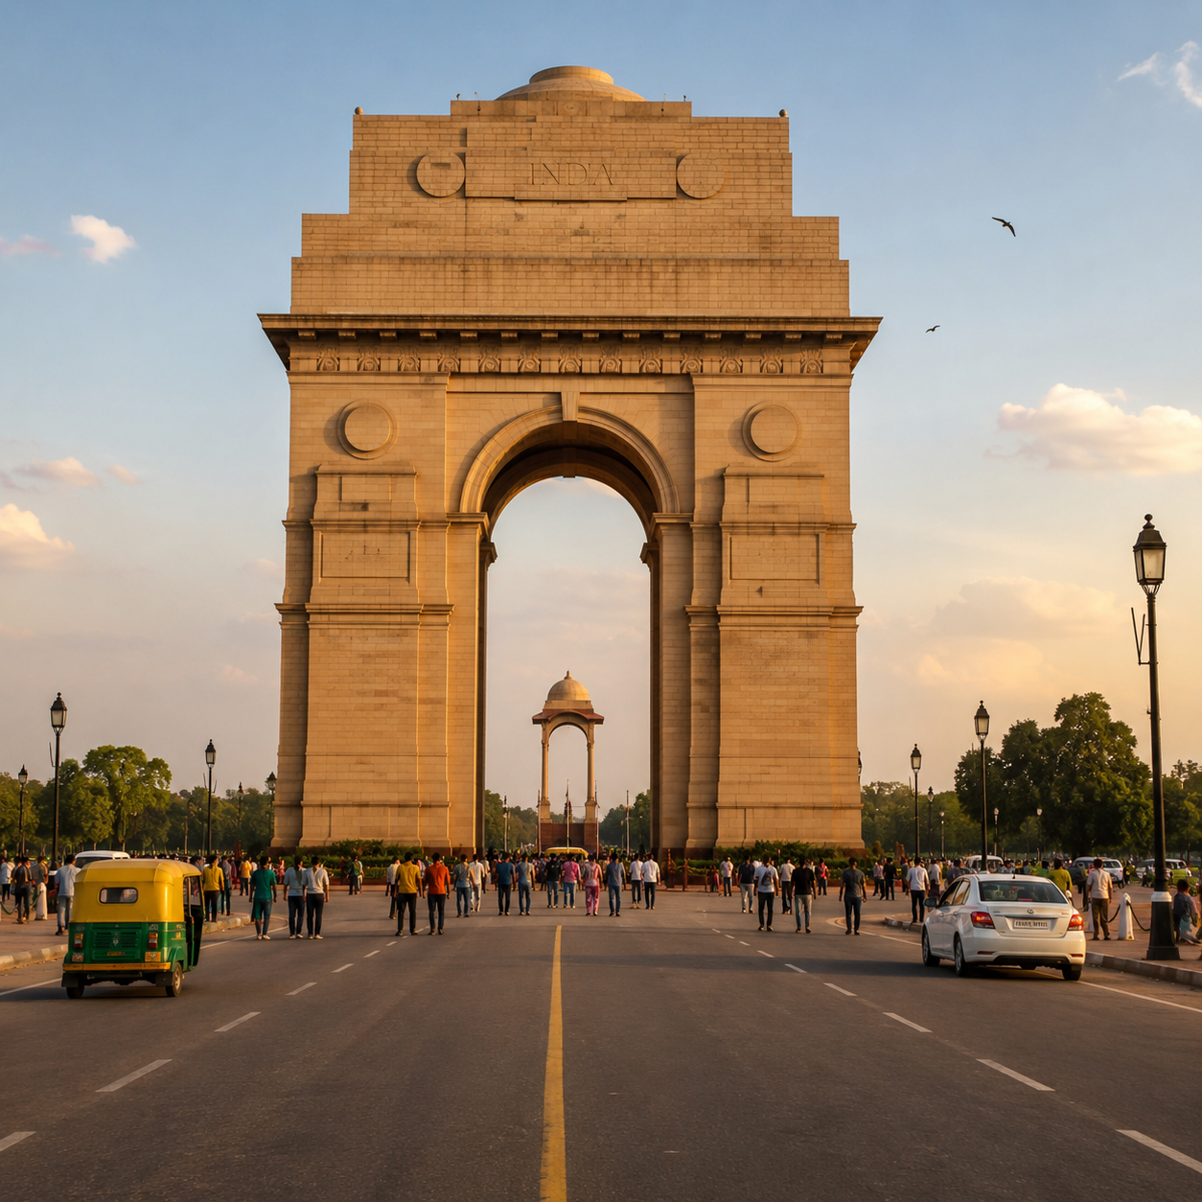
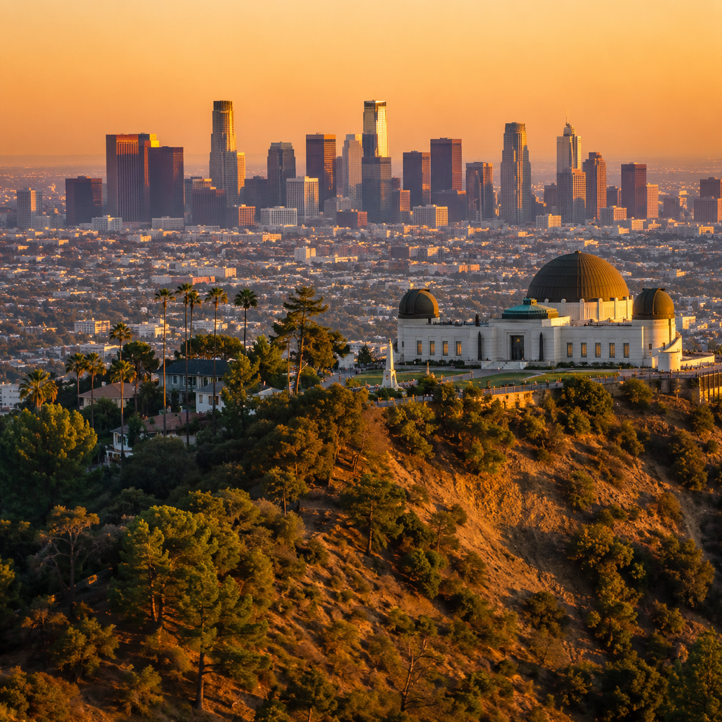
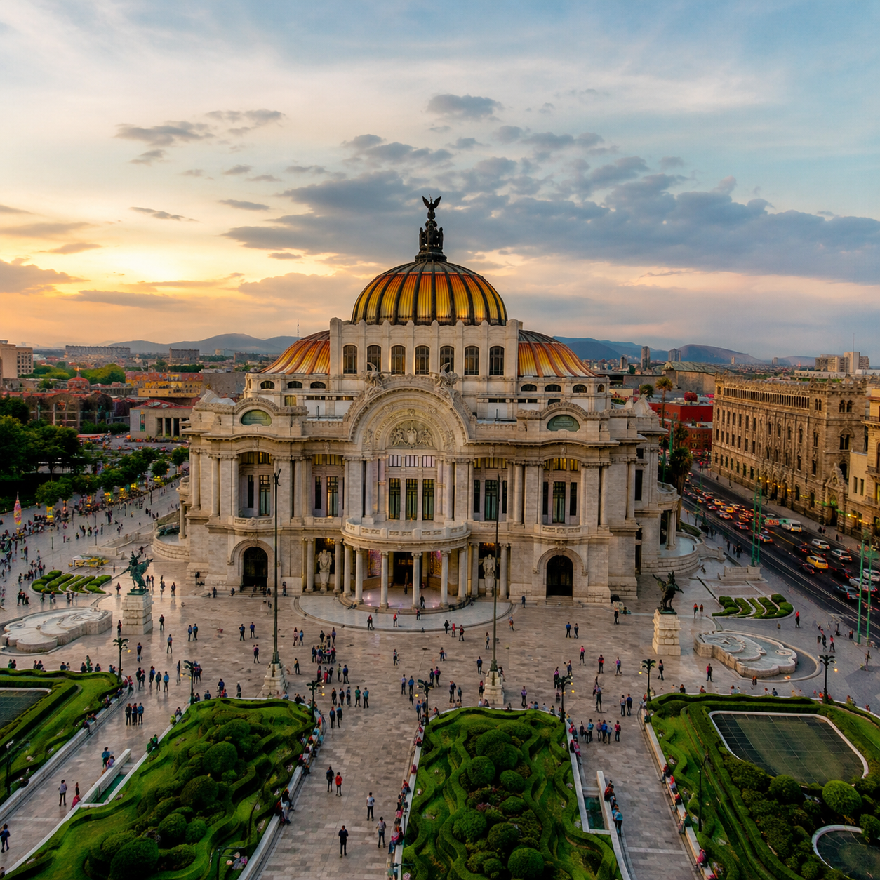
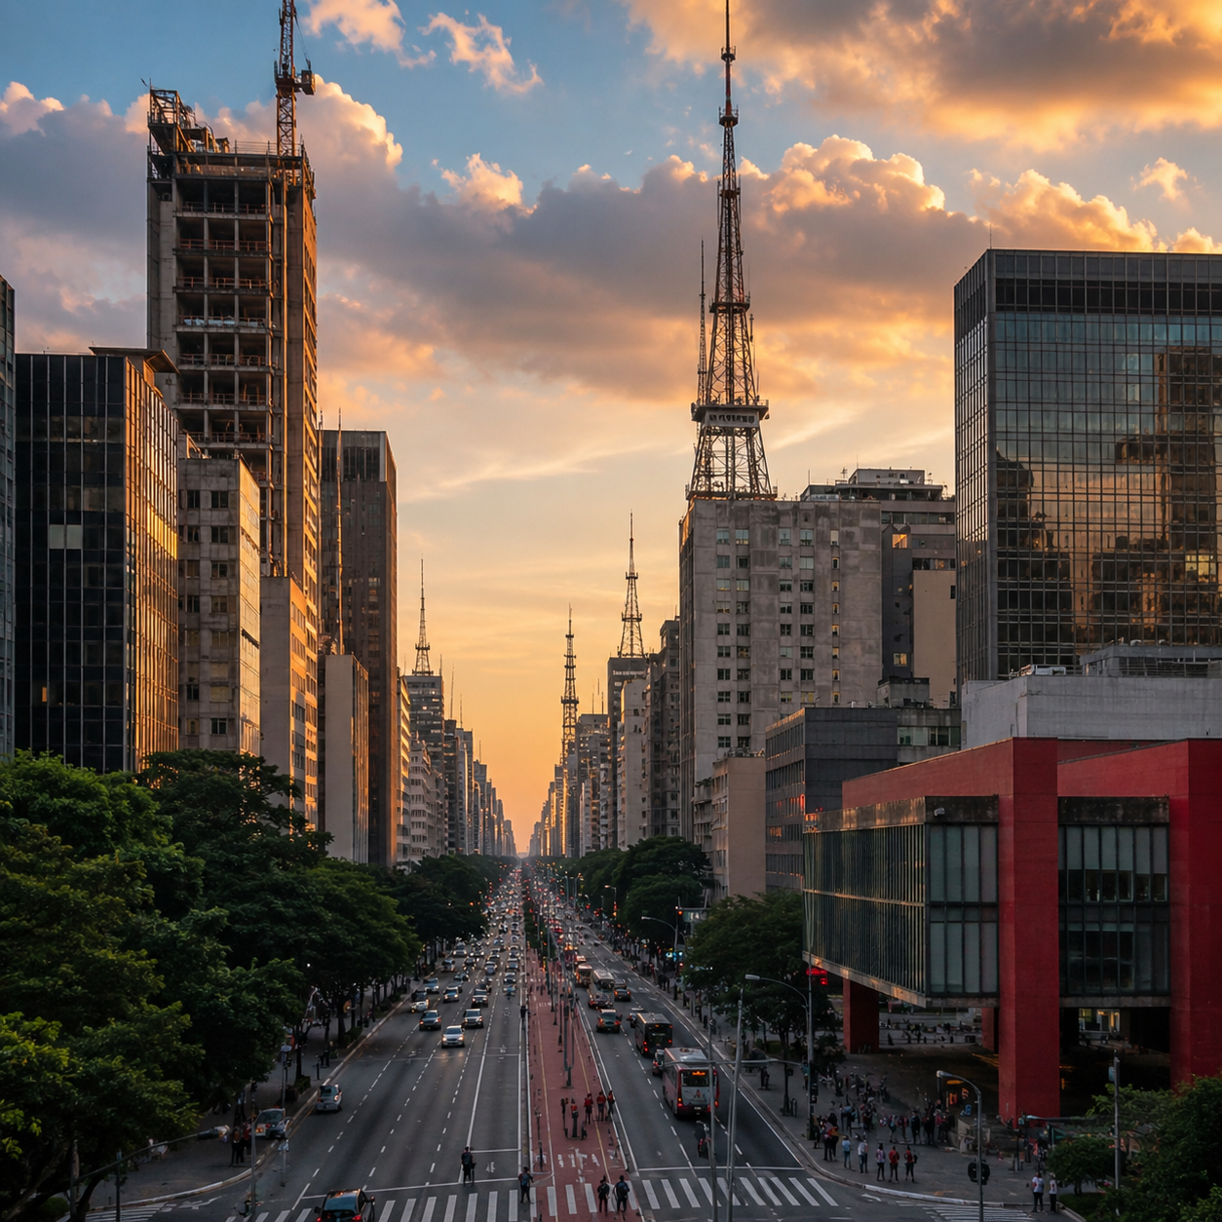
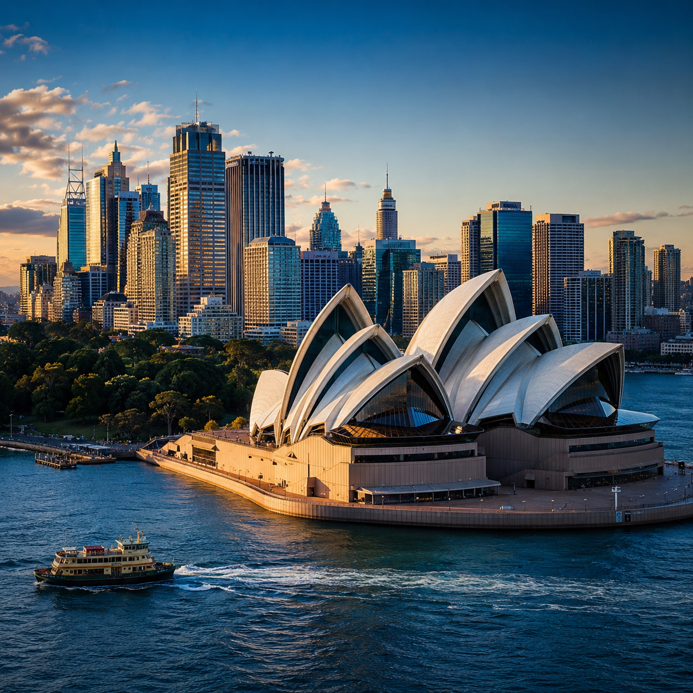
Huaven Civilization Initiative
Regional division of the 18 civilizational hub nodes
Tokyo-New Delhi-Los Angeles-Mexico City-São Paulo-Sydney
Incubate branch nodes in Japan and South Korea, while promoting the access and translation of Japanese and Korean content.
Incubate branch nodes in India, Nepal, Bhutan, Bangladesh, Sri Lanka and the Maldives, while promoting the access and translation of written-language content resources across the region.
Tokyo
New Delhi
Incubate branch nodes in the United States, Canada, Jamaica, Barbados, Guyana, Trinidad and Tobago, and the Bahamas, while promoting the access and translation of English-language content from North America.
Incubate branch nodes in Mexico, the Spanish-speaking regions of Central America, the Spanish-speaking Caribbean, Colombia, Venezuela, Ecuador, Peru and Bolivia, while promoting the access and translation of content resources in American Spanish, Mayan languages, Nahuatl and Andean languages.
Los Angeles
Mexico City
Incubate branch nodes in Brazil and other parts of South America, while promoting the access and translation of content resources in South American Portuguese, Guarani and Amazonian Indigenous languages.
Incubate branch nodes across Oceania, including Australia, New Zealand, Papua New Guinea, the Solomon Islands, Vanuatu and Fiji, while promoting the access and translation of regional language content.
São Paulo
Sydney
HC-C01-P00-PR00-PRM-PPT-S1-V1.1-EN-20260610001
Huaven Civilization Initiative
19

Slide 20
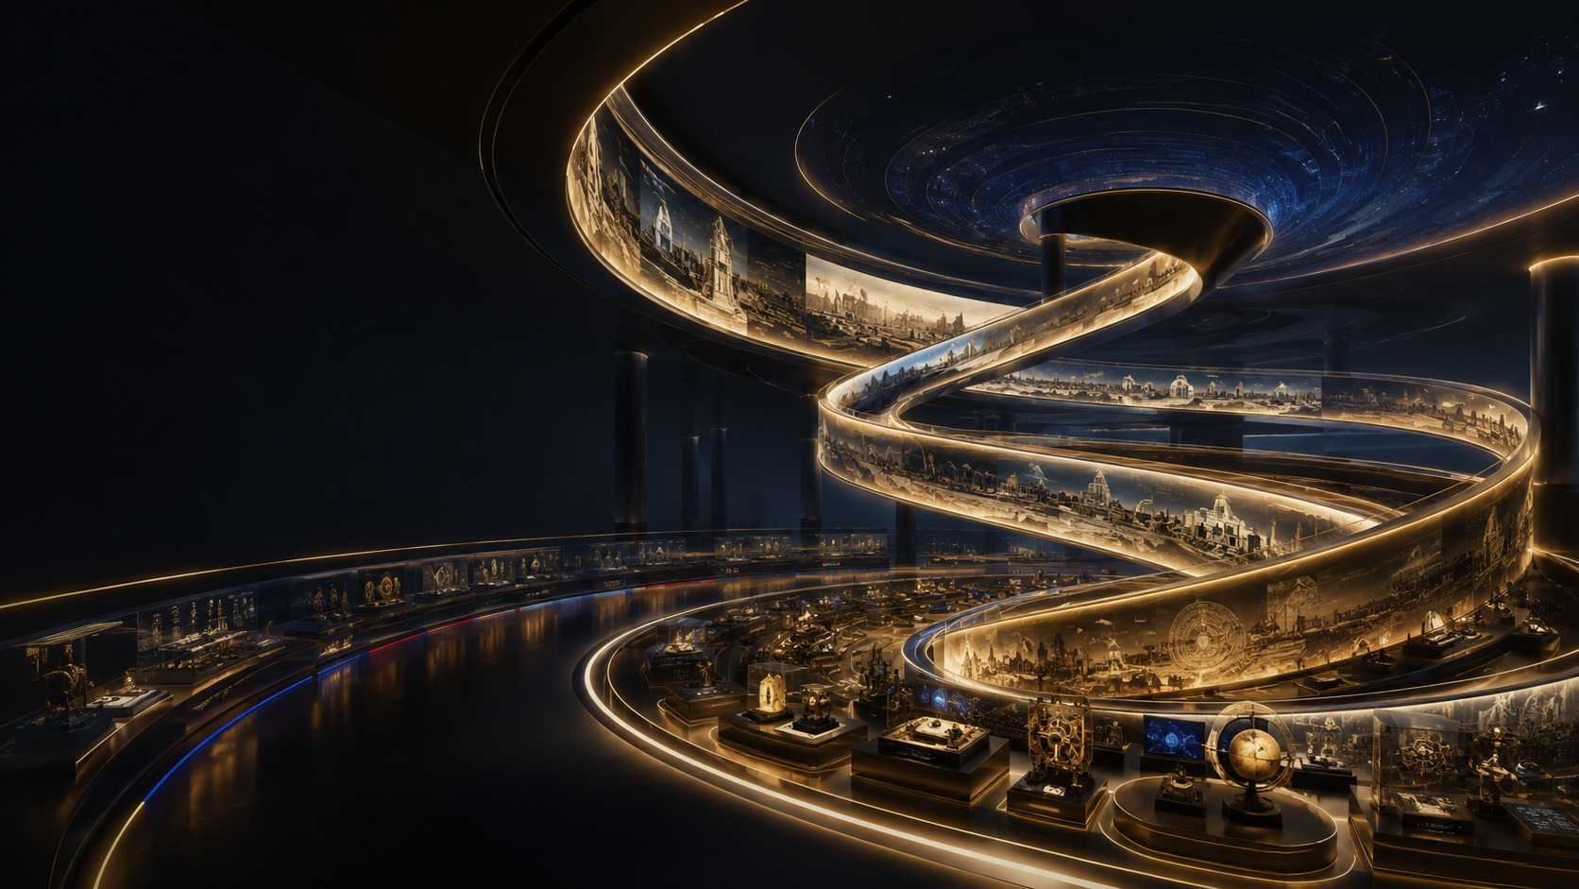
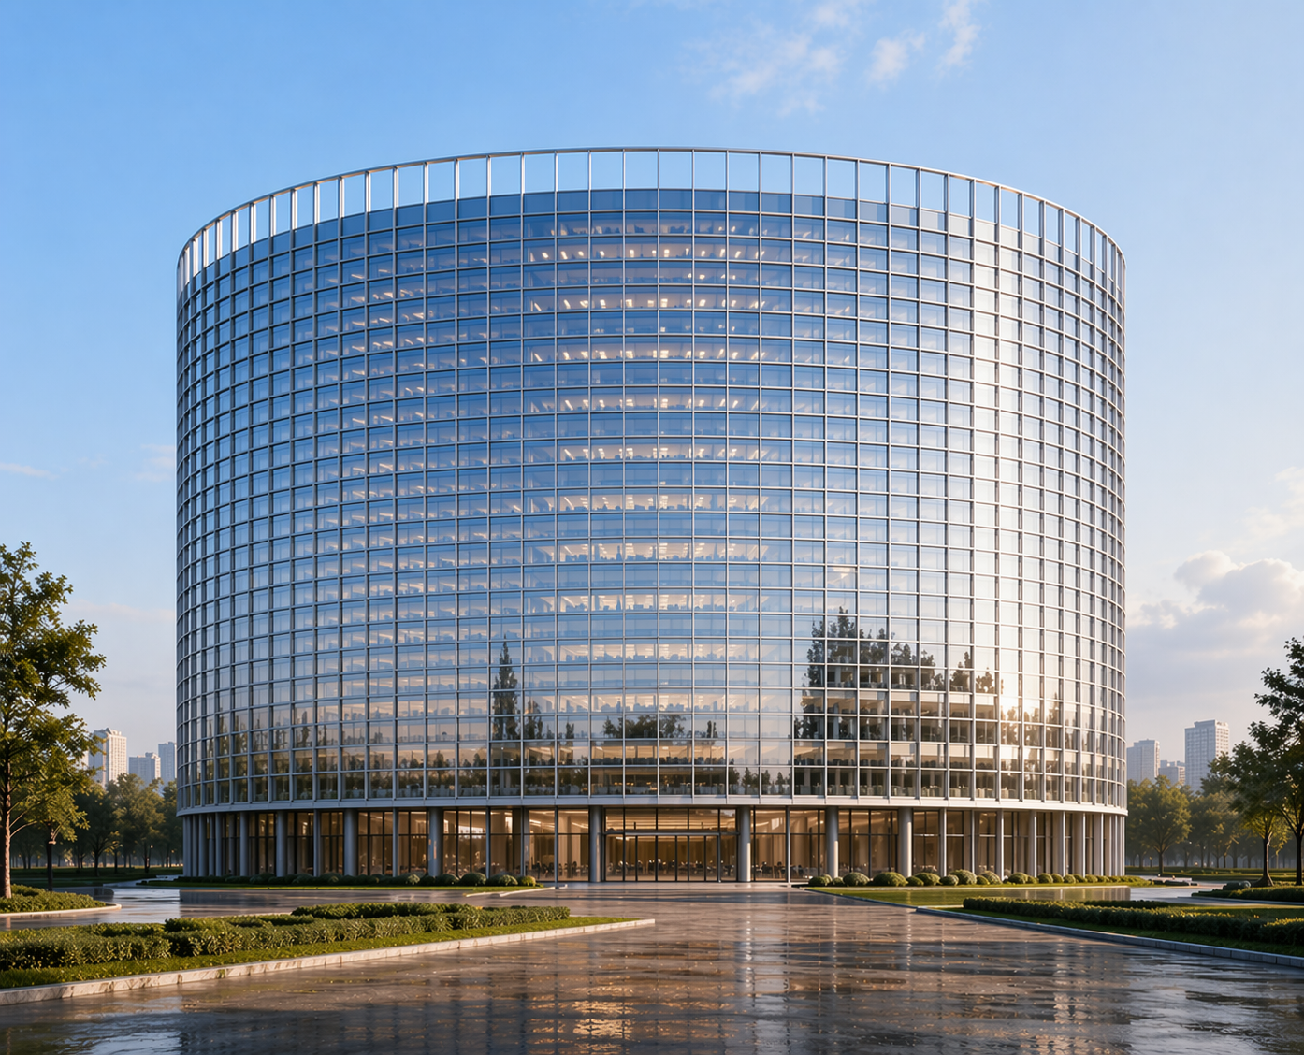

Huaven Civilization Initiative
Infrastructure of hub nodes: Civilizational Space
Use a single space of over 100,000 m² to carry the seeing, experiencing, thinking and transformation of civilizational achievements.
Super-Large Single-Site Space
100,000 m²+ single-building scale to form large-scale civilizational experience infrastructure
Ultra-Long Kilometer-Scale Exhibition Wall
A complete exhibition of the 3,600-meter scroll, displayed in one continuous sequence from beginning to end.
Immersive Continuous Experience
Reduce partitions and frequent scene transitions, allowing viewing, reflection and experience to unfold continuously.
Integration of Macro and Micro Perspectives
From macro-level civilizational landscapes to micro-level detailed observation, train multi-layered understanding capabilities.
From Observation to Transformation
Through viewing, experiencing, identifying, questioning and creating, transform cognition into capability.
Civilizational Space connects global museums by exhibiting replicas of major cultural treasures, showcasing world civilization, and guiding visitors to the institutions that house the originals.
HC-C01-P00-PR00-PRM-PPT-S1-V1.1-EN-20260610001
Huaven Civilization Initiative
20

Slide 21
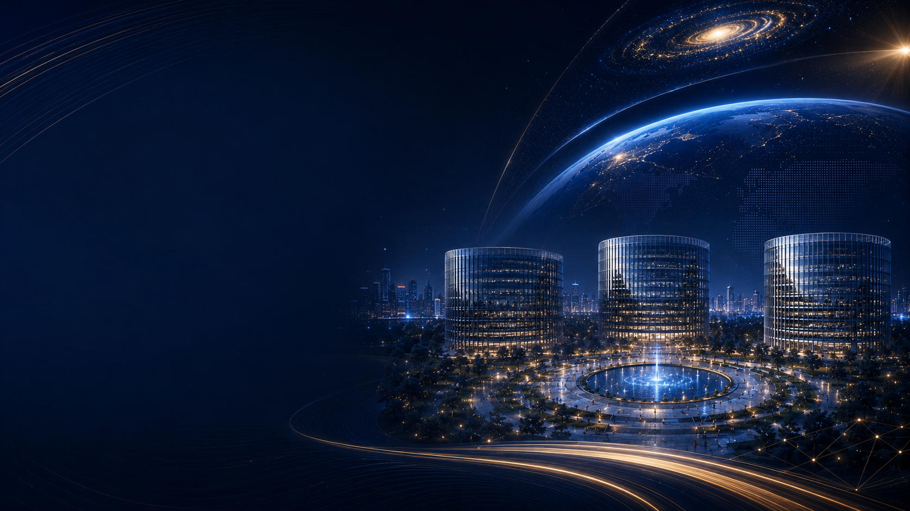
Huaven Civilization Initiative
What is displayed in Civilizational Space?
Let classics, tools, methods, ideas and future achievements meet in one space.
1. Classic Civilizational Achievements
2. Contemporary Frontier Achievements
Display the classic texts, art, institutions, thought, figures and historical creations of different civilizations, enabling people to see where civilizations come from.
Display frontier explorations and achievements in AI, robotics, life sciences, aerospace, energy, materials, computing and urban governance, enabling people to see where civilization is heading.
3. Tools and Methods
4. Problems and Tasks
Display the tools, methods, models, processes and training systems through which humanity solves problems, enabling people not only to see achievements, but also to learn the methods behind them.
Display major issues such as education, language, the environment, technology, population, governance and civilizational fractures, guiding people from viewing into reflection and from cognition into questioning.
5. Multilingual Translation and Civilizational Comparison
6. Co-Creation Matching and Outcome Transformation
Display how different languages, regions and civilizations express the same concept and solve the same problem, forming cross-civilizational understanding.
A matching space for projects, talent, capital, institutions, technologies and problems, enabling intellectual outcomes to find application scenarios and civilizational achievements to be transformed on site.
HC-C01-P00-PR00-PRM-PPT-S1-V1.1-EN-20260610001
Huaven Civilization Initiative
21

Slide 22
Huaven Civilization Initiative
Incubation site of hub nodes: Huaven City
From civilizational experience facility to integrated civilizational infrastructure
Regional Radiation Engine
Language Translation Engine
Industrial Transformation Engine
City Traffic Engine
Civilizational Momentum Engine
Huaven City expands Civilizational Space into a complex urban ecosystem.
HC-C01-P00-PR00-PRM-PPT-S1-V1.1-EN-20260610001
Huaven Civilization Initiative
22

Slide 23
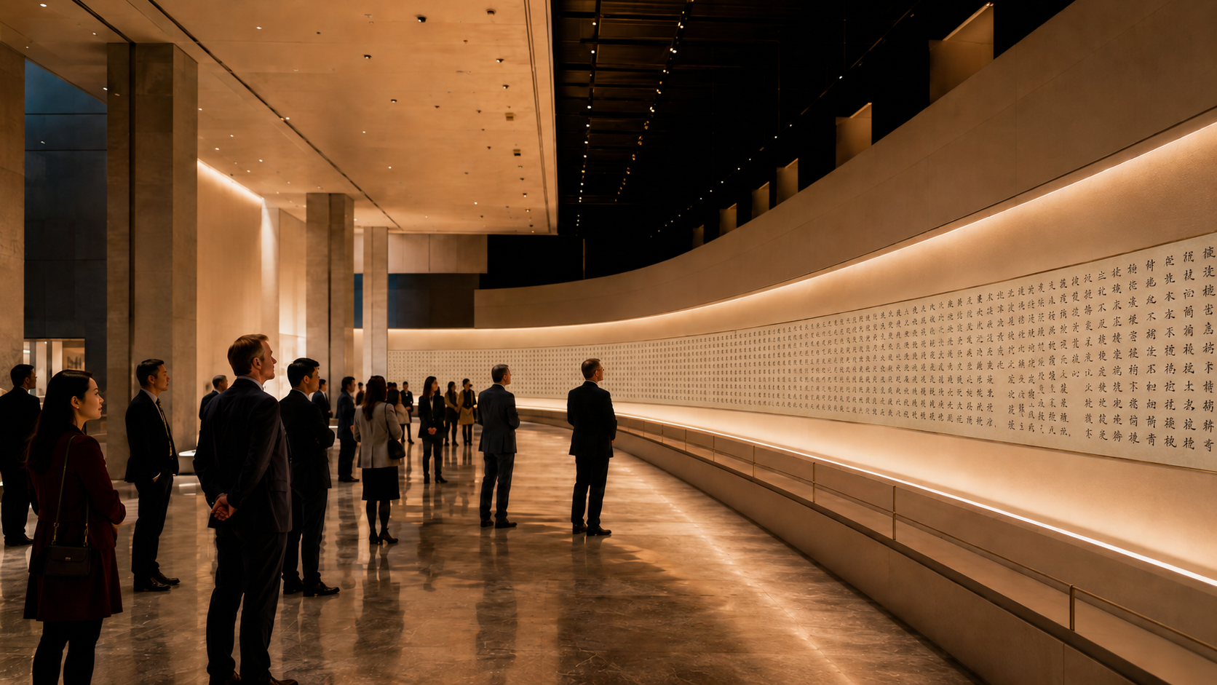
Huaven Civilization Initiative
Global Exhibition of Nine Unique 3,600-meter Civilizational Scrolls
Nine unique civilizational scrolls will be preserved, fully exhibited and publicly communicated at nine global hub nodes.
Scroll I | Chinese Region
Scroll II | Europe Region
Scroll III | North America Region
Candidate nodes：Hong Kong、Shanghai
Candidate nodes：Paris、Berlin、London
Candidate nodes：New York、Los Angeles、Mexico City
Scroll IV | East Asia–Southeast Asia Region
Scroll V | Eurasian Link Region
Scroll VI | South America Region
Candidate nodes：Singapore、Tokyo
Candidate nodes：Moscow、Istanbul
Exhibition node：São Paulo
Scroll VII | Middle East–South Asia Region
Scroll VIII | Africa Region
Scroll IX | Oceania Region
Candidate nodes：Dubai、New Delhi
Candidate nodes：Cairo、Johannesburg
Exhibition node：Sydney
Nine unique 3,600-meter scrolls are preserved and exhibited across global hub nodes.
HC-C01-P00-PR00-PRM-PPT-S1-V1.1-EN-20260610001
Huaven Civilization Initiative
23

Slide 24

Huaven Civilization Initiative
Mechanism of the initiative: combining public mission and business model
Public mission ensures legitimacy, business mechanisms ensure sustainability, and civilizational backup defines historical necessity.
Three major tasks humanity may need to complete next
1. Make Humanity Smarter and More Efficient
2. Establish Backups for Life and Species
3. Establish Backups for Civilization and Thought
The initiative participates in the first task, cooperates with the second, and launches the third.
HC-C01-P00-PR00-PRM-PPT-S1-V1.1-EN-20260610001
Huaven Civilization Initiative
24

Slide 25
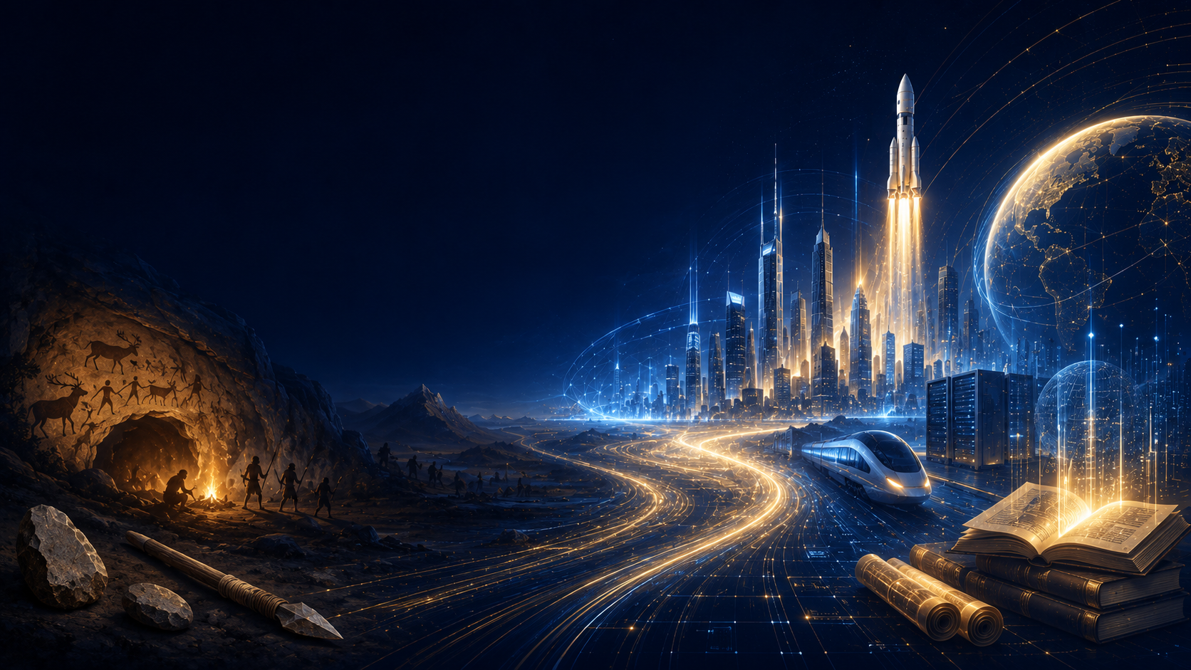
Huaven Civilization Initiative
Civilizational engineering and language translation concern the long-term interests of every country and humanity as a whole.
Every direction incubated by the initiative carries national-level significance.
The explanatory power of a language determines the level of civilization it is capable of carrying.
A language’s boundaries shape a nation’s civilizational reach in understanding the world, expressing thought, and creating the future.
If a language fails to expand its civilizational boundaries, it risks marginalization and eventual disappearance.
The Huaven Civilization Initiative helps languages empower one another and peoples advance together.
Language translation determines the ability of each people to enter future civilizational systems.
HC-C01-P00-PR00-PRM-PPT-S1-V1.1-EN-20260610001
Huaven Civilization Initiative
25

Slide 26
Huaven Civilization Initiative
Collaboration Architecture of the Initiative
The platform builds the framework; hub nodes organize resources; branch nodes fill content; the capital system drives scalable growth.
Huaven Civilization Platform
Civilizational Hub Node
Value Ecosystem
Set rules and protocols
authorize the brand
build systems and tools
create civilizational assets
shape global collaboration
launch the Civilization Fund
Mobilize talent and capital
incubate branch nodes
operate Civilizational Spaces
collect and translate content
connect partner institutions
expand thought through Q&A
Share long-term growth through cross-shareholding
Coordinate development through contribution funds
Incubate projects to increase equity value
Accumulate space, brand and content assets
Amplify capital to multiply node value
HC-C01-P00-PR00-PRM-PPT-S1-V1.1-EN-20260610001
Huaven Civilization Initiative
26

Slide 27
Huaven Civilization Initiative
Governance Structure of the Initiative
From conceptual layer to governance layer to execution layer
Governance Framework
Huaven Council
Node Governance Committees
Direction: vision, principles, protocols, standards
Platform: systems, data, brand, interfaces
Nodes: authorization, evaluation, operation, incubation
Capital: investment, funds, returns, risk control
Incentives: distribution, participation, contribution value, incentive pools
Civilization Guardianship: bottom lines, civilizational balance
Strategic Advisory: expert consultation, strategic advice
Standards: rules, protocols, authorization, standards
Content & Translation: content, translation, quality certification
Finance & Investment: funds, investment, incubation
Arbitration: dispute resolution, review, enforcement
Integrity & Audit: supervision, audit, risk contro
lSecretariat & Six HQs: execution layer
Operations: daily operations, space management, events
Content & Translation: content, translation, certification
Talent & Institutions: talent, institutions, collaboration
Capital Cooperation: investors, funds, capital coordination
Project Incubation: screening, transformation, branch incubation
Finance & Compliance: finance, audit, compliance
Governance structure: council coordination, node governance and execution centers.
HC-C01-P00-PR00-PRM-PPT-S1-V1.1-EN-20260610001
Huaven Civilization Initiative
27

Slide 28
Huaven Civilization Initiative
Investment requirements for a single hub node
Each hub node corresponds to one Huaven City, with an area between 200,000 and 1,000,000 m² and capital needs ranging from hundreds of millions to tens of billions of USD.
Investment category Launch-type node Standard node Flagship node
Huaven City Infrastructure Development US$200M–4B US$500M–10B US$800M–15B+
Civilizational Space Setup Investment US$50M–500M US$100M–1B US$100M–1B+
Content & Translation Investment US$50M–500M US$200M–1B US$300M–1.5B+
Team & Daily Operations Investment US$50M–200M US$200M–1B US$200M–1.5B+
Node Project Incubation Fund US$150M–600M US$500M–2B US$1B–5B+
Total Investment US$500M–5.8B US$1.5B–15B US$2.4B–24B+
Investment requirements for a single hub node and Huaven City.
HC-C01-P00-PR00-PRM-PPT-S1-V1.1-EN-20260610001
Huaven Civilization Initiative
28

Slide 29
Huaven Civilization Initiative
How capital enters hub nodes
Use node funds as capital entry points, project companies as investment vehicles, and phased construction plus rolling incubation to reduce single-point investment pressure.
Node Fund Investment
Huaven City Asset Investment
Civilizational Space Special Investment
Content and Translation Investment
Investment in Incubated Projects
The Node Civilization Fund supports the entire process of hub-node development and project incubation.
Invest in Huaven City’s land, buildings, commercial spaces, and supporting urban infrastructure.
Invest in Civilizational Space exhibitions, Long Scroll displays, and immersive systems.
Invest in content libraries, translation centers, copyright partnerships, and multilingual outreach.
Invest in node-incubated project companies, branch nodes, and translation centers.
Each hub node should adopt a phased model: initial launch, continuous fundraising and rolling investment through node funds and project incubation.
HC-C01-P00-PR00-PRM-PPT-S1-V1.1-EN-20260610001
Huaven Civilization Initiative
29

Slide 30
Huaven Civilization Initiative
Cross-shareholding and capital exit mechanism
Connect the platform, nodes, branches and projects through equity, and improve liquidity through multiple exit paths.
Cross-shareholding
Exit paths
Platform → Nodes: brand, systems, rules and global interfaces create platform equity.
Nodes → Platform: nodes share long-term platform growth through funds or strategic equity.
Nodes → Branches: hub nodes incubate and hold equity in branch nodes.
Funds → Projects: node funds invest in content, translation, education, AI, IP and data projects.
Projects → Nodes: mature projects feed back through revenue sharing, licensing, services and replication.
M&A Exit: Mature projects are acquired by industry groups, funds, or other nodes.
Internal Transfer: Establish internal equity transfer, buyback, and succession mechanisms within the Civilization Initiative.
Capital Market Exit: Exit through IPOs, SPACs, REITs, quasi-REITs, or portfolio securitization.
Fund Share Exit: Exit through fund share transfers, follow-on fund takeovers, or institutional acquisitions.
Asset Securitization Exit: Securitize Civilizational Spaces, commercial facilities, copyright revenue packages, and project equity portfolios.
Cross-shareholding and exit mechanisms connect platform, nodes, branches and projects.
HC-C01-P00-PR00-PRM-PPT-S1-V1.1-EN-20260610001
Huaven Civilization Initiative
30

Slide 31

Huaven Civilization Initiative
Logic for amplifying hub-node investment returns
Base returns support operations, asset appreciation strengthens the foundation, and project incubation plus capital relay opens growth space.
Node Funds | Project Companies | Branch Replication | Cross-Node Synergy | Government Support | Asset Securitization | Financial Derivatives | Unicorn Portfolio
Capital amplification
Revenue logic: base cash flow, asset appreciation and capital amplification.
Asset appreciation
Urban Landmarks | Preferential Land | Policy Incentives | Brand IP | Content Data | Regional Civilization Network Expansion
Revenue logic: base cash flow, asset appreciation and capital amplification.
Tickets | Memberships | Events | Courses | Training | Study Tours | Translation | Copyright | Publishing | Cultural Products | Art Trading | Brand Collaborations | Venue Rental | Retail | Live Events | Forums | Institutional Tenancy | Data Services | Certification | Sponsorship | Regional Monetization
Base cash flow
Revenue logic: base cash flow, asset appreciation and capital amplification.
The Civilization Initiative is more than a project. With national-level support behind each incubated venture and hundreds of nodes in continuous incubation, it will form a unique civilizational capital ecosystem.
HC-C01-P00-PR00-PRM-PPT-S1-V1.1-EN-20260610001
Huaven Civilization Initiative
31

Slide 32
Huaven Civilization Initiative
Vision: the world after the global civilizational network is built
Measure long-term impact through connection scale, language interoperability, expression balance, innovation collaboration, capital scale and self-defined indexes.
User connections
Language interoperability
Language/civilization expression share
translation backup output
10 Years: 500 Million
20 Years: 1 Billion
30 Years: 2 Billion
Global Population Coverage Targets
10 Years · 80%
20 Years · 90%
30 Years · 95%+
Rebalancing Global Language Expression
Current: English 90%+; other languages below 10%
10 Years: non-English expression reaches 20%+
20 Years: reaches 35%+
30 Years: reaches 50%+
Multilingual Translation Output Targets
10 Years · 100T Tokens
20 Years · 300T Tokens
30 Years · 900T Tokens
problem discovery and solution volume
civilizational creative output
civilizational capital ecosystem target scale
capability improvement index
10 Years: 50 Billion Times
20 Years: 200 Billion Times
30 Years: 1 Trillion Times
Original Creation Targets
10 Years · 100M Items
20 Years · 500M Items
30 Years · 2B Items
Civilizational Capital Ecosystem Targets
10 Years · US$500B
20 Years · US$2T
30 Years · US$10T
Human Capability Improvement Targets
10 Years · 2–3×
20 Years · 5–10×
30 Years · 10–30×
Thirty-year vision and indicators for the global civilizational network.
HC-C01-P00-PR00-PRM-PPT-S1-V1.1-EN-20260610001
Huaven Civilization Initiative
32

Slide 33
Huaven Civilization Initiative
Co-construction investment and equity structure of hub nodes
Civilizational hub nodes are not simple partners; they are long-term co-builders of a global civilizational network.
1. Node Co-Development Fees and Investment
3. Civilization fund return mechanism
4. Node co-construction rights
US$10M–30M
Used to co-build the brand and platform, and receive 0.5%–1.5% corresponding rights.
Infrastructure and Hub Node Fund:Based on local land and construction costs, and used for hub node construction and operation.
Global Civilizational Hub Status Rights
Council or Rotating Council Participation Rights
Long Scroll Inscription and Nomination Quotas
Node Naming Rights
Global Forum Hosting Rights
Historical Inclusion and Huaven City Monument Inscription Rights
Priority Project Incubation Rights
Priority Investment Rights and Strategic Investment Quotas
Revenue Distribution Rights
Priority Access to Global Resource Allocation
3.5% of Annual Net Operating Income
Supports global translation, question banks, public tools, youth talent, and low-resource language civilizations.
2. Node performance deposit
US$5M–15M
Ensures node development progress, operating standards, translation delivery, content access, and resource coordination.
Joining a hub node is not merely participating in a project; it secures a core position in the future civilizational network and leaves co-builders a place in the initiative’s history.
HC-C01-P00-PR00-PRM-PPT-S1-V1.1-EN-20260610001
Huaven Civilization Initiative
33

Slide 34
Huaven Civilization Initiative
Phase-One Implementation Roadmap
From the opening scroll to the mature operation of a global civilizational network
2026
Launch the Huaven Civilization Initiative: refine the website, white paper, presentation, cooperation agreements, and node standards.
2026–2029
Complete the Nine Unique Long Scrolls and launch cooperation across the 18 major hub nodes.
2027–2030
Register the 18 major hub nodes and form the initial global civilizational network.
2028–2032
Launch the first Huaven Cities and open Civilizational Spaces for public experience.
2030–2036
Complete all 18 major hub nodes, expand to 36 hubs, and operate a mature global civilizational network.
HC-C01-P00-PR00-PRM-PPT-S1-V1.1-EN-20260610001
Huaven Civilization Initiative
34

Slide 35
Huaven Civilization Initiative
Current launch needs: funding, development, team building and resource connections
Use launch funding to complete the initial loop of credibility building, platform prototype, core team and agency cooperation system, then implement prototype nodes and global layout step by step.
1. Startup Funding
2. Global Campaigns & Core Team
3. Platform Development
4. resource connection
Initial Launch: US$20M–50M
Fast Launch: US$50M–100M
Complete the platform website, tool prototypes, cooperation materials and core team; complete the 108 inscriptions, the global “Ten Thousand Seals and Ten Thousand Chapters” campaign, and the Nine Unique Civilizational Long Scrolls; establish the global agency system, confirm the 18 hub nodes, and connect strategic investment.
Prepare and launch the 108 Inscriptions and “Ten Thousand Seals and Ten Thousand Chapters” global campaigns to raise worldwide visibility.
Build core teams across technology, product, content, financing, business, design, communications, operations, and management.
Build the official website and platform prototype, including the content library, question bank, resource library, task system, agency management, node information system, and AI tool prototypes.
Connect investors, entrepreneurs, family offices, HNWIs, overseas Chinese resources, technology partners, agents, and node investment partners to build the first pipeline of funding, agency, technology, and node-development leads.
Launch needs: funding, global activities, platform development, team and resource connections.
HC-C01-P00-PR00-PRM-PPT-S1-V1.1-EN-20260610001
Huaven Civilization Initiative
35

Slide 36

Huaven Civilization Initiative
Three types of partners currently sought
At this stage we need not spectators, but people who can bring resources, raise capital, implement development and keep advancing the work.
1. Project Agents
2. Node Investment Partners
3. Executive Partners
Project agents connect investors, entrepreneurs, family offices, HNWIs, overseas Chinese resources, and potential partners. They are long-term resource connectors within the global node network, creating sustainable cooperation channels and revenue sources through investment, city resources, corporate resources, and regional partnerships.
Core Value: Moving the project into high-value resource networks
Organize regional funding, resources, and partners to move hub nodes from negotiation to implementation: register the node entity, build the local team, connect government, capital and enterprises, secure Huaven City land or spaces, and launch branch nodes, activities, and fund platforms.
Core Value: Spark civilizational hubs across the globe
Responsible for global team building and daily operations.
Financing | Talent | Technology | Content & Communications | Global Operations | Management & Organization
Core Value: Breaking a grand vision into actionable daily work.
Early partners are the first igniters who turn the Civilization Initiative from vision into reality.
HC-C01-P00-PR00-PRM-PPT-S1-V1.1-EN-20260610001
Huaven Civilization Initiative
36

Slide 37
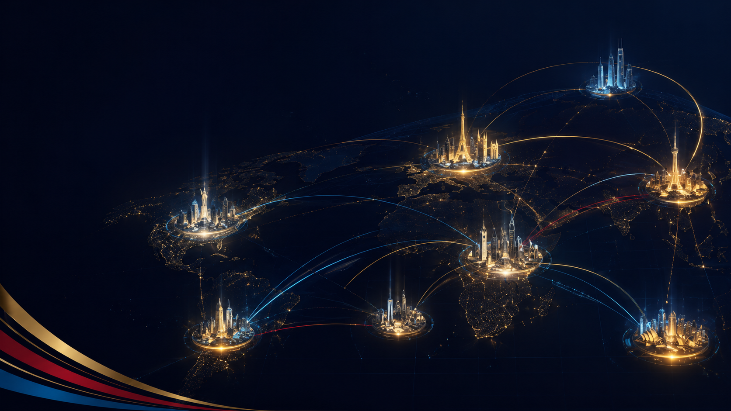
Huaven Civilization Initiative
Cooperation Advancement Process
From initial communication to signed co-construction, use a clear process to bring resources, capital, nodes and execution teams into place.
Agency IntentConfirm
connectable resources and agency intent.
Agency Confirmation
Define the agency territory and sign the agency agreement.
Resource Connection
Arrange introductions, meetings, roadshows, and agreement discussions.
Close Cooperation
Facilitate node investment partnership and receive agency rewards.
Follow-Up
Support ongoing communication between both cooperation parties.
Investment Intent
Confirm the investment city, receive project materials, and discuss agreement terms.
Agreement Signing
Sign the cooperation agreement and carry out the agreed responsibilities.
Node Preparation Launch
Establish the node entity, create the Civilization Fund, and formulate the node operation plan.
Node Operation
Build the node team, develop branch nodes, and begin phased normal operations.
Build Huaven City
Invest in Huaven City infrastructure development.
Contact Us
Partner Intent
Define partner roles based on each party’s capabilities and resources.
Trial Cooperation
Clarify phased tasks and establish mutual working alignment.
Long-Term Role Confirmation
Define the partner’s long-term role based on trial cooperation results.
Project Participation
Take part in advancing the Civilization Initiative and sharing its outcomes.
HC-C01-P00-PR00-PRM-PPT-S1-V1.1-EN-20260610001
Huaven Civilization Initiative
37

Slide 38

Huaven Civilization Initiative
Invitation to
the Civilizational Initiative
We are seeking global agency partners, civilizational node initiators and execution partners to jointly complete a civilizational initiative that may influence humanity.
Cooperation Contact
E-mail：info@huaven.org
HC-C01-P00-PR00-PRM-PPT-S1-V1.1-EN-20260610001
Huaven Civilization Initiative
38

